Slide 1


Free software for the surveillance and containment of infectious diseases and antimicrobial resistance

Slide 2


What is WHONET?
WHONET is a widely-used free software developed for the management and analysis of microbiology laboratory data to support local, national, regional, and global activities to understand and fight infectious diseases with a special focus on antimicrobial resistance in the human, animal, food, and environmental sectors.
Division of Infectious Diseases, Brigham and Women’s Hospital, Boston, United States
WHO Collaborating Centre for Surveillance of Antimicrobial Resistance

Slide 3
What is the challenge?
Antimicrobial resistance is projected to cause 1.91 million deaths directly and be associated with 8.22 million deaths annually by 2050*
Infectious diseases are a major and growing cause of morbidity, mortality, and healthcare costs.
Resistance containment efforts and evaluation of their impact are hampered by the lack of relevant data to support effective local, national, regional, and global action.
A nearly
70%
increase in
deaths compared
to 2021*
* O’Neill reports

Slide 4

How WHONET solves the problem

Slide 5
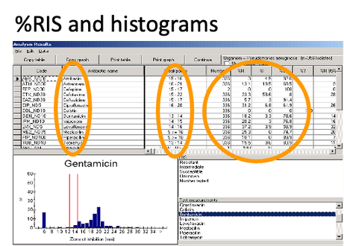
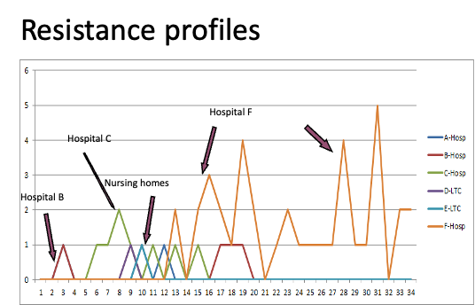
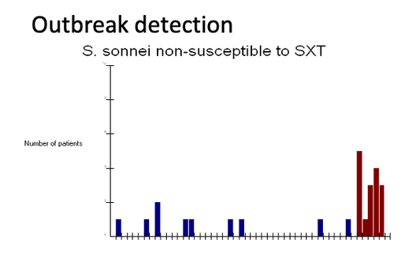
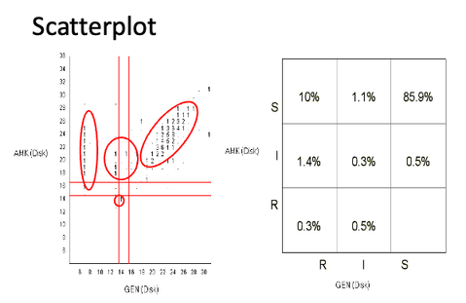
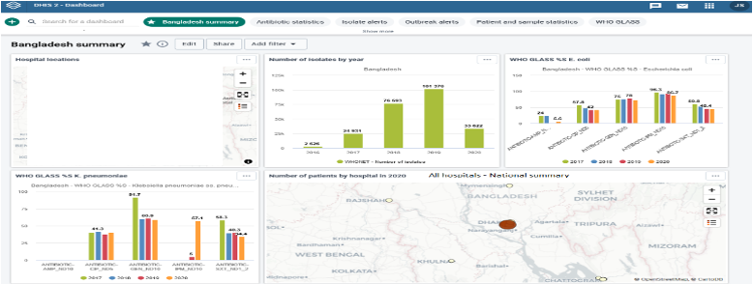
WHONET
Permits the entry, integration, analysis, and sharing of data from microbiology laboratories worldwide to support:
  Infection and resistance containment
  Recognition, tracking, and containment of emerging threats in real-time
  Treatment guidelines and antimicrobial stewardship programs
  Public health awareness, advocacy, policy, and interventions
  Basic science, clinical, and operational research
  Continuous quality improvement in laboratory practices and diagnostic stewardship
BacLink
A data capture utility within the WHONET package that permits the download, standardization, and exchange of otherwise incompatible data resources from diverse information systems.
The WHONET Automation tool
Permits the automated daily, weekly, monthly, and quarterly generation of reports to key stakeholders to support timely and focused action.

Slide 6
Dr. John Stelling,
MD, MPH
Adam Clark,
BS in Computer Science
Dr. Stelling, Director of the WHO Collaborating Centre or Surveillance of Antimicrobial Resistance at the Brigham and Women’s Hospital, has been leading WHONET software development, dissemination, and support since joining founder Dr. Thomas O’Brien in 1989.
He spent three years as a Medical Officer with the WHO Antimicrobial Resistance Containment Unit. He is a technical advisor to WHO, FAO, many other nongovernmental organizations, Ministries of Health, and professional societies supporting the translation of available microbiology laboratory data into resistance containment policies and interventions.
WHONET Software developer since 2011. Mr. Clark is responsible for the delivery of robust and secure software to meet the goal of extracting and presenting actionable information to decision-makers in a timely manner.
He leads the development of the WHONET package including WHONET, BacLink, WHONET Automation Tool, and customized utilities for partner projects.He provides training and technical support to WHONET users worldwide.
The
Team

Slide 7
History &
Statistics
Created in
1989
by Dr. Thomas O’Brien
& John Stelling
Available in
56
Languages
The majority of data submissions to important international surveillance initiatives is created by export from WHONET databases including:
  WHO Global Antimicrobial Resistance and Use Surveillance System (WHO GLASS)
  International FAO Antimicrobial Resistance Monitoring program (InFARM)
  European Antimicrobial Resistance Surveillance Networks in both human and animal health (EARS-Net and EARS-Vet)
Over 500 pier-reviewed publications in the international medical literature rely on WHONET for data management included data from 110 countries. This number is dwarfed by a much larger number of reports and articles in the “gray literature” comprising local, national, and projects reports which have not been submitted to international journals.
Used by
>9,000
healthcare, public health, and academic institutions
Used in
>130
Countries

Slide 8
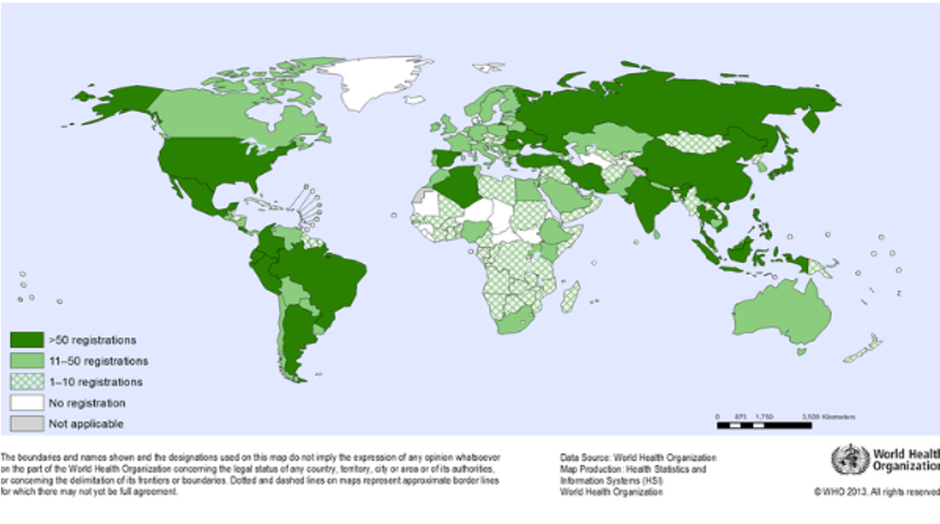
Worldwide Registrations

Slide 9
WHONET has had a significant impact on our work, facilitating the management and analysis of antimicrobial resistance data in a standardized and efficient manner. The use of the platform has enabled us to improve the quality of reporting, more rapidly identify resistance trends, and support clinical and public health decision-making based on reliable data.
Diana Perde
Head of the National Reference Laboratory for Healthcare-Associated Infections and Antimicrobial Resistance,
NAPH,
Chisinau City, Republic of Moldova
In the low resource setting (Afghanistan), this is very crucial to have WHONET to get the correct data on AMR. There are no validated microbiology laboratories and microbiology experts in the country, WHONET is a best support in each and every health section.
Monibullah Shinwari
Laboratory Manager,
Medicine Sans Frontiers,
Kabul, Afghanistan
Voices From The Field
Before adopting WHONET, data consolidation and analysis were largely manual, time-consuming, and prone to errors. With WHONET, our laboratory personnel can now easily encode culture and sensitivity results, standardize organism identification, and generate antibiograms with just a few clicks.
Hasbiah Comacasar
Medical Technologist III,
Amai Pakpak Medical Center,
Marawi City, Philippines
WHONET is the gold standard for transforming raw data into life-saving insights.
Thandavarayan Ramamurthy
Senior Scientific Consultant,
Kolkata, India
WHONET remains one of the most practical and impactful tools available for strengthening AMR surveillance systems, and I continue to recommend it widely in my international work.
Jens Thomsen
Medical Microbiologist,
Medics Labor AG,
Bern, Switzerland

Slide 10
From my very first day working in the hospital as a medical microbiology resident, WHONET immediately fascinated me. It has become an essential tool in my daily work, helping me understand resistance patterns, monitor trends, and contribute more effectively to patient care and infection control.
Mădălina-Alina Nechita
Clinical Microbiologist,
ESCMID,
Cluj-Napoca, Romania
The more we use the platform, the more our staff discover new features about the WHONET and we still keep using the system.
Sorie I.O Bangura
Microbiology Lead,
Ministry of Health,
Freetown, Sierra Leone
Voices From The Field
At present, 30 sentinel sites across the country are actively utilizing WHONET for data management and analysis... The use of WHONET has greatly enhanced the capacity to monitor resistance patterns, enabling more evidence-based and rational use of antimicrobials.
Dr. Priyantha Athapattu
Deputy Director General -
Laboratory Services,
Ministry of Health & Mass Media,
Colombo, Sri Lanka
Overall, WHONET has significantly improved the quality, consistency, and usability of AMR surveillance data for evidence-based decision-making.
Godwin Minga
Head of Microbiology /AMR and InFARM FP - CVL,
Central Veterinary Laboratory,
Dar es Salaam, Tanzania
The Maldives published its first National AMR Surveillance Report in 2025, utilizing WHONET as the data analysis tool.
Ahmed Ziyad
Medical Laboratory Specialist in Microbiology and Immunology,
Indhira Gandhi Memorial Hospital / Dharumavantha Hospital,
Malé, Maldives

Slide 11

Funds
Needed
$600,000
Minimal annual funding level
$1,500,000
Desired annual funding level

Slide 12


Use of Funds
  Software development and technical support utilities and services
  Travel funds to support training and strategic meetings
  Staff – Minimal level:
    Project coordinator
    Software engineer
  Staff – Desired level:
    Project coordinator
    Software engineer 1. Ongoing core software maintenance and development
    Software engineer 2. Platform modernization and new directions
    Technical support, training, and communications coordinator

Slide 13

Contact Information
Dr. John Stelling MD, MPH
Director WHO Collaborating Centre for Surveillance of Antimicrobial Resistance
Brigham and Women’s Hospital
75 Francis Street
Boston, MA 02116
Email: jstelling@whonet.org
Website: www.whonet.org

