Slide 1

WHONET and Antibiograms
John Stelling, MD, MPH, jstelling@whonet.org
Brigham and Women’s Hospital, Harvard Medical School, Boston
WHO Collaborating Centre for Surveillance of Antimicrobial Resistance

Slide 2
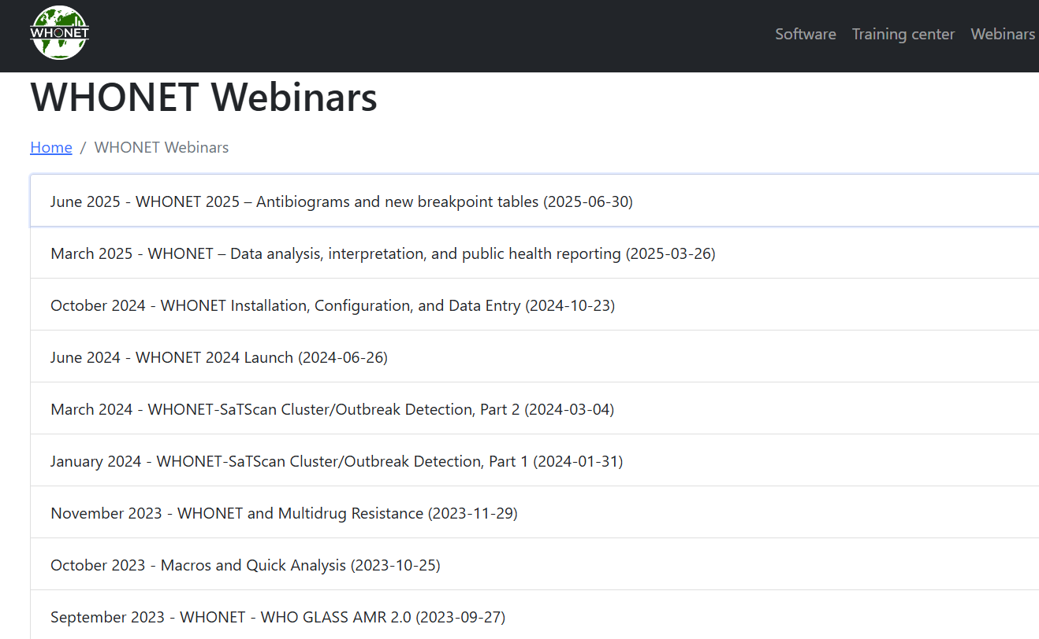
WHONET Webinar series
You can find the videos for past webinars on the WHONET Home Page, www.whonet.org, click on “Webinars”.

Slide 3
Webinar agenda
Part 1. Antibiograms – Introduction, recommendations, and examples
  A few comments about the “new” WHONET breakpoint tables
Part 2. Antibiogram preparation with WHONET
Thank you to Janet Hindler and Jens Thomsen for many years of support and collaboration. A number of the slides in this presentation come from work that they have put together.

Slide 4
Part 1: Antibiograms – Introduction, recommendations, and examples

Slide 5
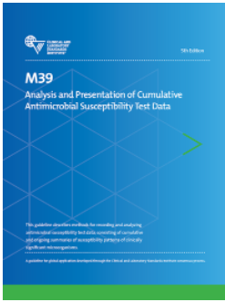
CLSI M39: Analysis and Presentation of Cumulative Antimicrobial Susceptibility Test Data
Purpose
Guides the preparation of antibiograms by the laboratory and the use of data by clinicians for selecting most appropriate antimicrobial agents for empirical therapy for initial infections when definitive AST results are not available.
Guidance
Collection, storage, and analysis of data
Preparation of reports
  Routine and enhanced antibiograms
  Guide selection of empiric antimicrobial therapy
Data Presentation
  Body site, hospital unit, specific patient populations
Example antibiogram templates
Slide from Jens Thomsen
https://clsi.org/standards/products/microbiology/documents/m39/
Requires purchase for use; copyright restrictions about sharing.

Slide 6
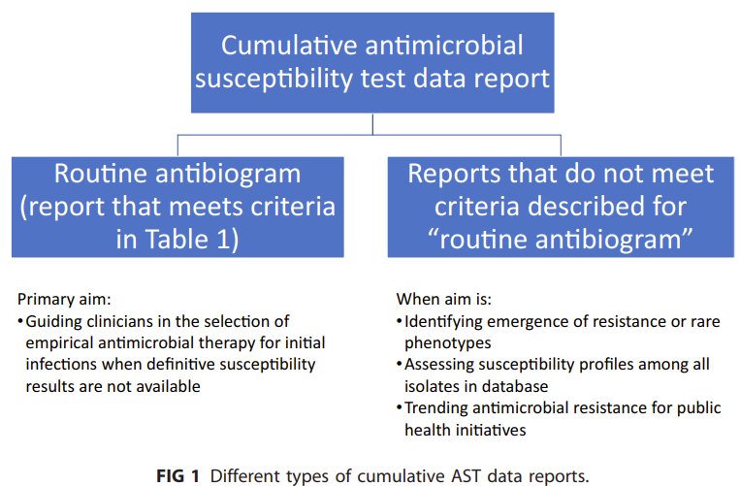
CLSI M39 Types of cumulative AST data reports
Routine
Enhanced
Multi-facility
Quality assessment
  Correct antibiotics tested?
  Unexpected resistance?
  Unexpected susceptibility where there should be intrinsic resistance?
  Unexpected comparisons within a drug class?

Slide 7
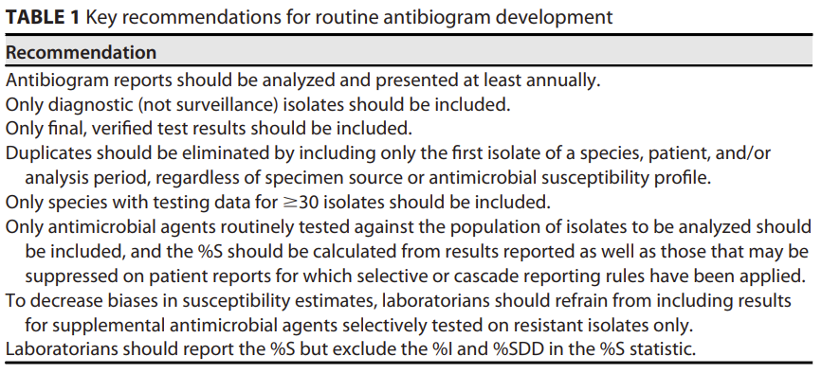
CLSI M39 Key recommendations for routine antibiograms

Slide 8
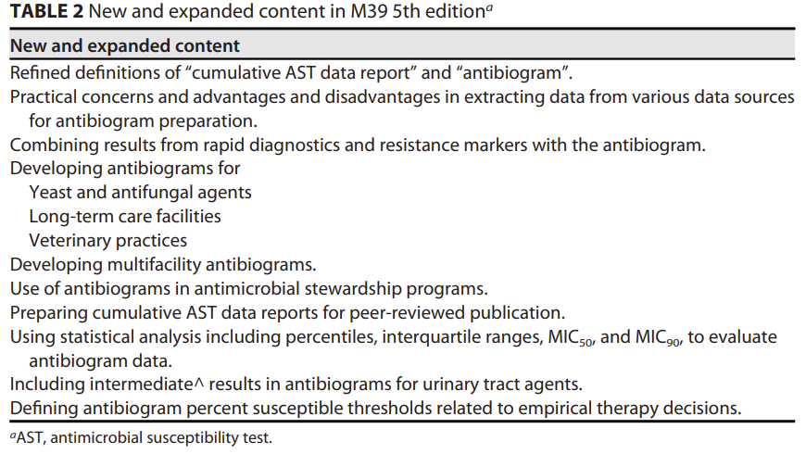
CLSI M39 – New content in the fifth edition

Slide 9
Sources of bias in routine diagnostic samples
Isolates with AST results
Testing biases
Patients with microbiology samples
Sampling biases
Patients who come to a medical clinic
Patient presentation biases
Patients with pathogens
Patient risk factors
Healthy individuals with commensal microbes
Demographic biases

Slide 10


5
The impact of bias on results
A
There are two primary consequences of bias in laboratory-based studies of antimicrobial resistance.
Underestimation of disease burden: There are often no specimens collected from the majority of patients with disease.
Overestimation of resistance rates: Specimens are often collected in patients with treatment failures, with complicated medical histories, and with long hospital stays.
There are no simple or inexpensive strategies to avoid bias. Well-designed protocols can help to minimize bias, and these are worthwhile. However, they are often resource-intensive, time-limited, and focus on a few priority conditions in a few clinical site

Slide 11
5
The interpretation of biased data
A
It is crucial to keep the issue of bias in mind whenever we review results, and we must proceed cautiously when making conclusions and recommendations.
For certain surveillance objectives, the impact of biases can be devastating to appropriate quality policy decisions, while for others, the impact of bias is less.
High impact: Standard treatment guidelines, disease burden estimates
Medium impact: Advocacy and awareness
Lower impact: Outbreak detection, trend monitoring, recognition and confirmation of new resistance, continuous quality improvement in laboratory services.

Slide 12
Antibiograms to support treatment guides
- The Danger
Many patients with simple community infections have no diagnostic samples collected and processed by the microbiology laboratory
Samples processed by the microbiology laboratory often represent patients with treatment failures, complicated medical histories, and recent hospitalizations.
  This is true in all countries – but especially in low-resource settings
The “observed %S” from routine clinical samples are often much lower than the “true %S” seen in a general community population.
  For example, the laboratory might observe CIP %S = 70% for Escherichia coli in the routine diagnostic samples, but a “representative sample” from the general community might show that CIP %S = 90%.
As a result, clinicians might incorrectly decide avoid the use of CIP and select a higher-cost reserve agent instead.

Slide 13
Antibiograms to support treatment guides
- The Danger - Continued
Because of the risk of inappropriate therapy decisions by non-expert clinicians, some surveillance coordinators prefer to present %R rather than %S.
They choose to emphasize the value of the data in monitoring emerging resistance and de-emphasize the use of antibiograms by non-experts for therapy decisions

Slide 14
Important difference between CLSI and EUCAST
In CLSI, “I” = “Intermediate”. The bacteria may have decreased susceptibility to the antibiotic, and the clinical value of the antibiotic is uncertain.
  It makes sense to prepare antibiograms with “%S”.
In EUCAST, “I” = “Susceptible with increased exposure”. The bacteria has decreased susceptibility to the antibiotic, but with higher dosages, the antibiotic should be able to support a successful clinical outcome.
  There are a few reasonable options
    Present %S and %I separately.
    Present %S+%I. In WHONET, this is called “Non-Resistant”.
    Present the %S and the %S+%I separately

Slide 15
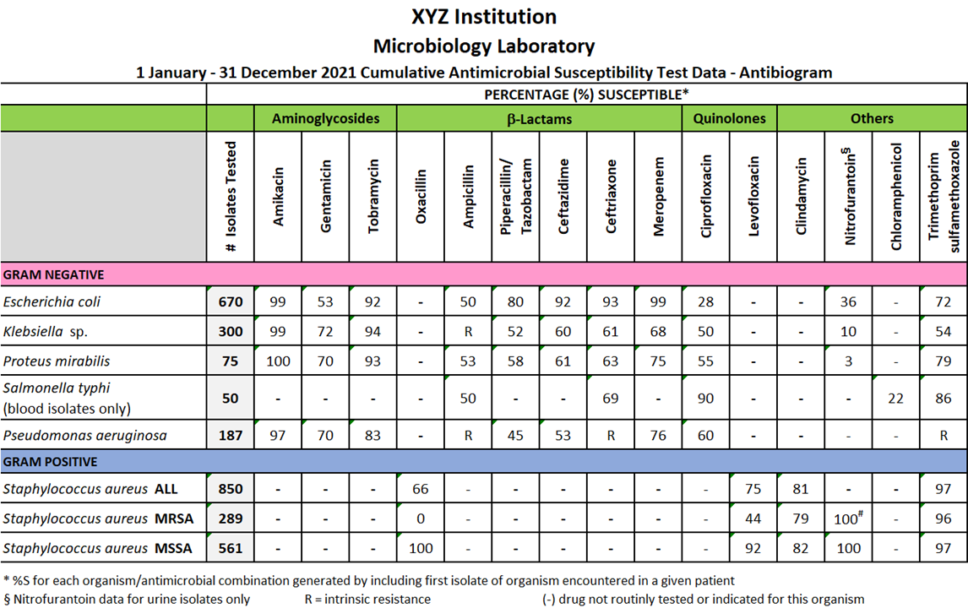
Key Elements of A Good Antibiogram
Facility name
% Susceptible
Time period
Antibiotics by Class
Number of isolates
Selective testing
‘-’: Drug not indicated or not tested
R: Intrinsic resistance
Footnotes
First isolate only
Slide from Jens Thomsen

Slide 16
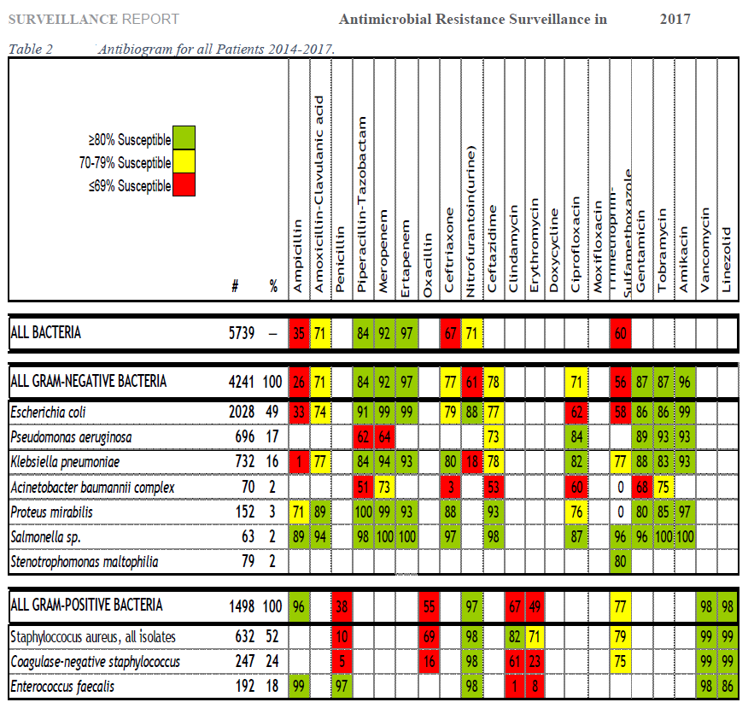
Use of colors in an antibiogram to assist in treatment decisions
The use of colors can be problematic
Biases in resistance estimates
  Resistance estimates derived from routine clinical samples often do not represent general community populations
What should the thresholds be?
  Does not consider evidence for clinical outcomes, such as “in vivo-in vitro” correlation
  Does not consider the severity of disease
Slide adapted from Jens Thomsen

Slide 17
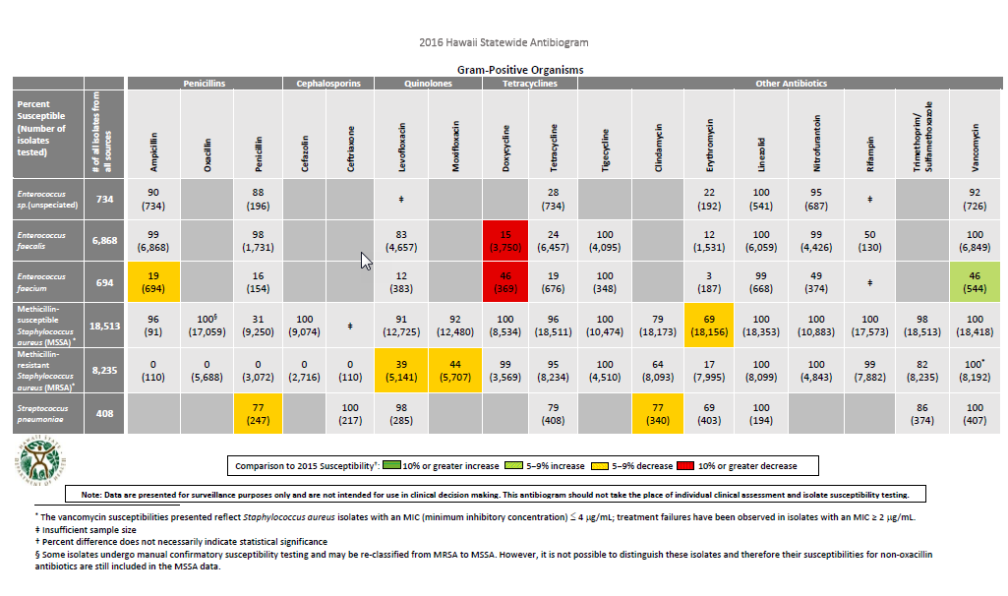
Use of colors to demonstrate trends (Hawaii)
Slide adapted from Jens Thomsen

Slide 18
Bloodstream Isolates of Gram-negative rods
Bloodstream Isolates, % Susceptible
Organism* | N | Cftrx | Cftaz | P-T | Mero | Amk | Tob | Cip
E. coli | 107 | 79 | 79 | 95 | 100 | 100 | 83 | 61
K. pneumoniae | 63 | 92 | 91 | 87 | 95 | 97 | 94 | 94
E. cloacae | 30 | 73 | 72 | 77 | 100 | 100 | 97 | 100
P. aeruginosa | 29 | - | 89 | 79 | 86 | 100 | 97 | 76
* Only a few representative species listed here as example.
Bloodstream Isolates, % Susceptible
All species combined (N = 339 patients)
Organism | N | Cftrx | Cftaz | P-T | Mero | Amk | Tob | Cip
All GNR | 339 | 72 | 80 | 84 | 92 | 94 | 86 | 77
Slide from Janet Hindler

Slide 19
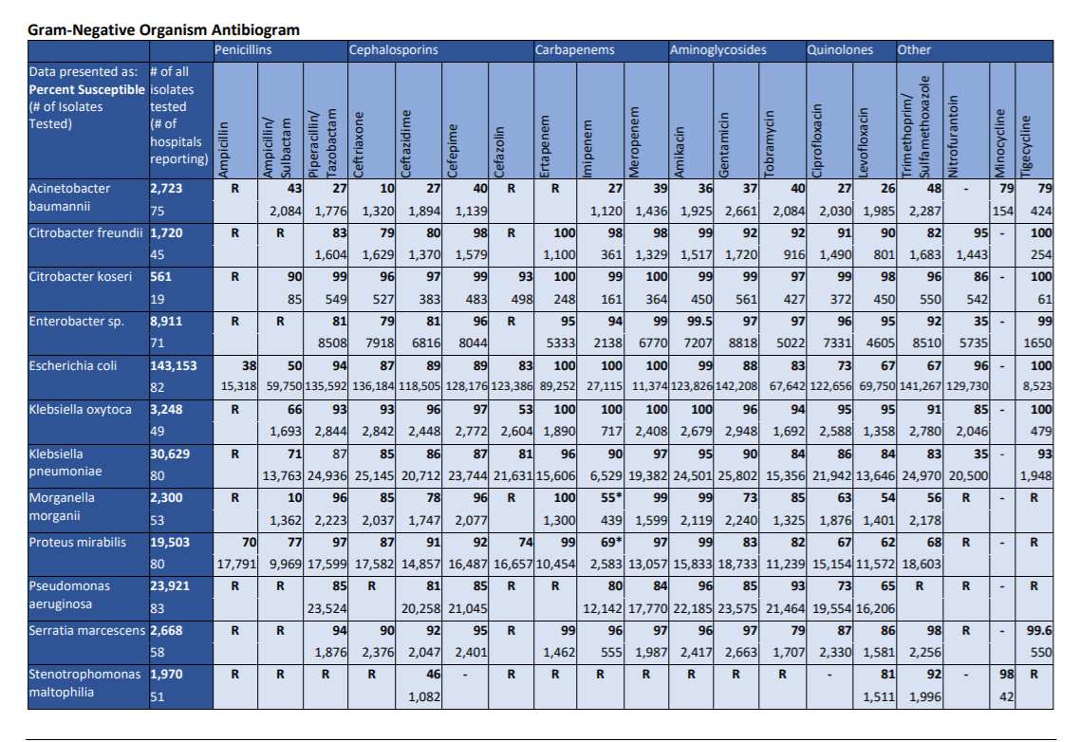

Los Angeles County Antibiogram 2017
Gram-Negative Organisms
Slide from Janet Hindler
http://publichealth.lacounty.gov/acd/AntibiogramData.htm

Slide 20
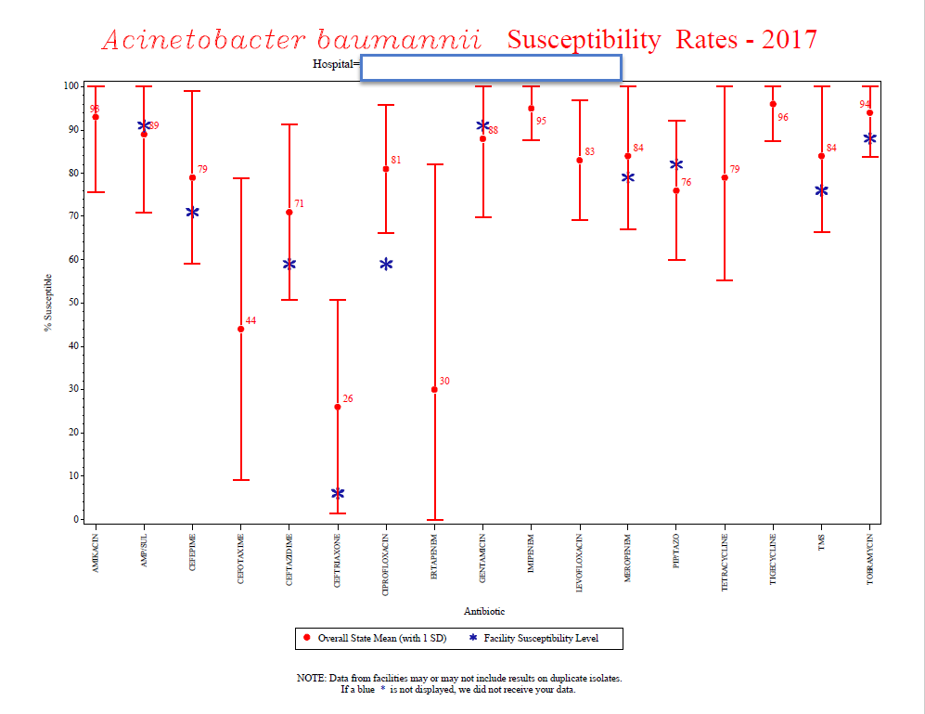
Massachusetts - Benchmarking antibiogram
Slide from Janet Hindler

Slide 21
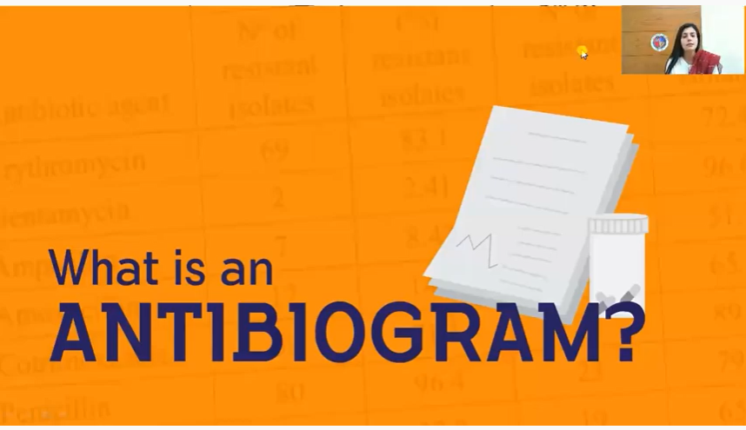


Antibiograms - Educational Videos
Sep 13, 2021 (~2 minutes)
July 18, 2022 (18 minutes)
Feb 20, 2021 (45 minutes)
https://www.youtube.com/watch?v=sGk5EvYnSBU
https://www.youtube.com/watch?v=FWTwQRXZml8
https://www.youtube.com/watch?v=2oLGjozTCSY
Slide from Jens Thomsen

Slide 22
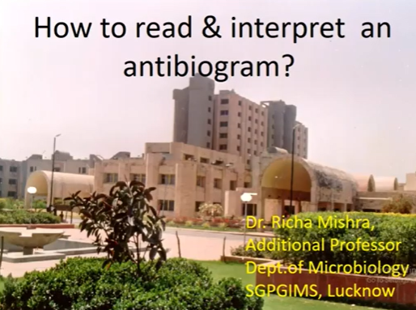
Antibiograms - Educational Videos
Apr 1, 2022 (38 minutes)
https://www.youtube.com/watch?v=_Duuh7d8_Eo
Slide from Jens Thomsen

Slide 23
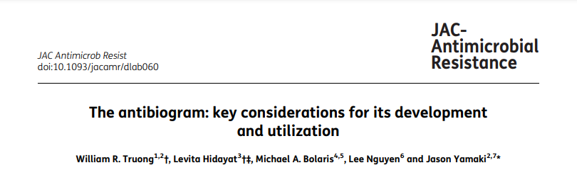
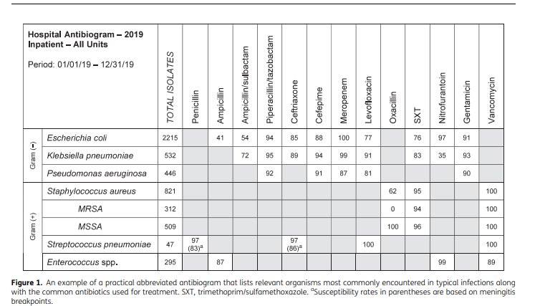
OPEN ACCESS
JAC Antimicrob Resist.
• 2021 Jun; 3(2): dlab060. Published online 2021 May 25.
https://www.ncbi.nlm.nih.gov/pmc/articles/PMC8210055/
Slide from Jens Thomsen

Slide 24

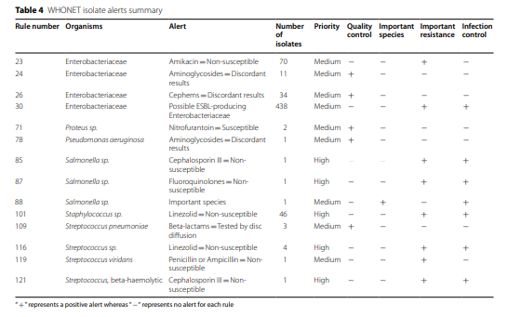
Antimicrobial Resistance & Infection Control
• 2022 Oct 3;11(1):122. doi: 10.1186/s13756-022-01160-5.
https://pubmed.ncbi.nlm.nih.gov/36192790/
Slide from Jens Thomsen

Slide 25
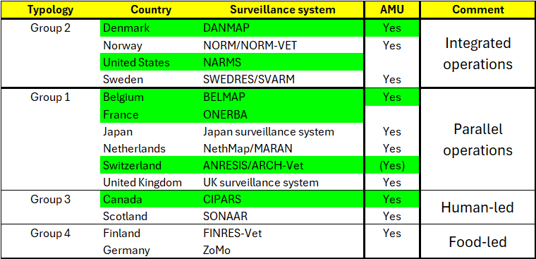
One Health Programs
Programs with interactive websites in green
BMC Public Health. 2024 Jun 27;24(1):1717.

Slide 26
One Health initiatives – Interactive websites
With Antimicrobial Use data
  Belgium
    belmap.shinyapps.io/BELMAP2024_App
  Canada
    www.canada.ca/en/public-health/services/surveillance/canadian-integrated-program-antimicrobial-resistance-surveillance-cipars/interactive-data.html
  Denmark
    www.danmap.org
  Switzerland
    www.anresis.ch/antibiotic-resistance
Without Antimicrobial Use data
  France
    Human: bigdata.onerba.org
    Animal: shiny-public.anses.fr/resapath2
  United States
    Human: wwwn.cdc.gov/narmsnow
    Animal and Food: www.fda.gov/animal-veterinary/national-antimicrobial-resistance-monitoring-system/narms-now-integrated-data

Slide 27
Useful links
CLSI pages for M39 and VET05
CLSI free resources: The CLSI pages have been reorganized.
NIH Search for: Stelling M39

Slide 28
New WHONET Breakpoint tables
Full compliance with CLSI and EUCAST breakpoint tables, especially important for animal health breakpoints
Integration of Epidemiological Cutoff Values
Integration of intrinsic resistance tables
Dynamic breakpoint selection – selection of years
Configurability of the breakpoint priorities
  Human/Animal/ECOFF, Meningitis/Nonmeningitis, Uncomplicated UTI/other
The WHONET tables (without the WHONET software) can be utilized for LIS developers within their own systems

Slide 29
Points to look out for
Intrinsic resistance rules
  Example: Klebsiella pneumoniae and AMP
  Old WHONET tables, WHONET might calculate 95% resistance based on the zone diameter or MIC measurements.
  New WHONET tables, WHONET will calculate 100% resistance because of the intrinsic resistance tables.
  One problem - This can hide mistakes in organism identification. So, for internal quality purposes, you can also turn off the intrinsic resistance tables to look for unexpected susceptibility.
More appearances of “?”
  Example: Pseudomonas aeruginosa and NIT
  Old WHONET tables, WHONET determined RIS using the “general” Gram-negative breakpoints based on Enterobacterales
  New WHONET tables, WHONET will presentation the interpretation as “?” since there are no breakpoints and this combination does not appear in the intrinsic resistance tables

Slide 30
Part 2: Antibiogram preparation with WHONET
  Manual antibiogram preparation
  WHONET macros
  WHONET Standard reports
  WHONET User-defined reports

Slide 31
Manual antibiogram preparation with WHONET
Analysis type
  %RIS and test measurements, 2. Summary
  Select “%S” or “%Non-Resistant”. (We might renamethis to %S+%I.)
One per patient
  “By patient”
  “First isolate with antibiotic results”
Organisms
  Select the organisms
  You can use “Analyze as one organism” for similar species
Isolate filters
  Choose filters – specimen type, location areas, gender, age group, resistance results, etc.
Data files
  Choose your data files
“Begin analysis”

Slide 32
Manual antibiogram preparation with WHONET
Demonstration

Slide 33
WHONET Macros
To create a macro, after you select your analysis parameters:
  “Macros”
  “New macro”
  Enter a name for the macro, for example “Gram-negative antibiogram” or “Gram-negative antibiogram in urine”
  “Save” to save the “Macro name”
  “Save” again to save the “Macro file”
  “Exit” to return to the analysis screen
To use a macro:
  “Macros”
  Select your macro
  “Load”

Slide 34
WHONET Macros
Demonstration

Slide 35
WHONET Reports
Standard reports
  Epidemiology report (for Microsoft Word)
  Antibiogram report (for Microsoft Excel)
  Demonstration
User-defined reports
  Create a new report using “Macros” that you have created.
  Demonstration

Slide 36
Thank you!

