Slide 1
WHONET laboratory database software
WHO Collaborating centre for surveillance of antimicrobial resistance
Laboratory configuration: alerts

Slide 2
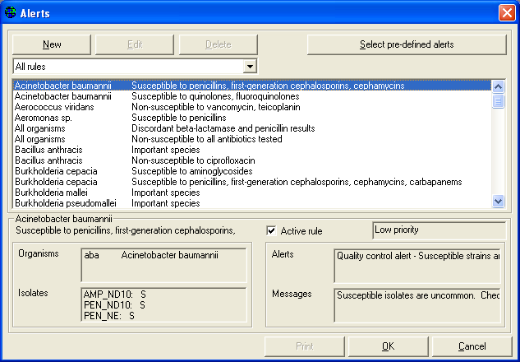
Part 1. Isolate alerts
Figure 12.
List of microbiological alerts for your laboratory. In addition to the pre-defined WHONET alerts, you can also define your own alerts with “New”.
From the main configuration screen, click on “Alerts”.
You will see a long list of microbiological alerts suggested by WHONET – alerts about possible laboratory errors, important results that should be confirmed at the local or national level, and findings that should be communicated to other groups, such as the infection control team.

Slide 3
Part 1. Isolate alerts
Figure 12.
From the main configuration screen, click on “Alerts”.
You can easily activate or deactivate the rules suggested by WHONET.

Slide 4
Part 1. Isolate alerts
Figure 12.
You can also use “New rule” to define additional alerts specific to your institution or country.
You can also use “New rule” to define additional alerts specific to your institution or country.

Slide 5
Part 1. Isolate alerts
Figure 12.
When you finish reviewing or defining rules, click on “OK” to return to the main configuration screen.
When you finish reviewing or defining rules, click on “OK” to return to the main configuration screen.

Slide 6
Part 1. Isolate alerts
Figure 12.
You can also use “New rule” to define additional alerts specific to your institution or country.
You can also use “New rule” to define additional alerts specific to your institution or country.

Slide 7
Part 1. Isolate alerts
Figure 12.
When you finish reviewing or defining rules, click on “OK” to return to the main configuration screen.
When you finish reviewing or defining rules, click on “OK” to return to the main configuration screen.

Slide 8
Thank you!
On behalf of the WHONET Team, thank you for learning about the WHONET & BacLink Software!

