Slide 1
WHONET laboratory database software
WHO Collaborating centre for surveillance of antimicrobial resistance
locations

Slide 2
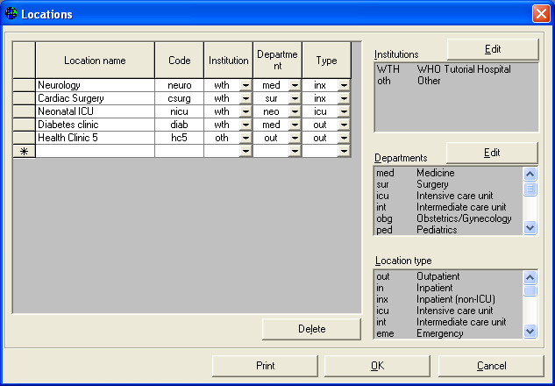
Part 1. Patient locations
If you entry data manually into WHONET, it would be useful to enter a list of the most common patient locations from which you get clinical isolates.

Slide 3
Part 1. Patient locations
Note: If you work in a public health, veterinary, or food laboratory setting, you can use the “Location” field to refer to whatever location would be of most relevance for your work – hospital, city, farm, abattoir, restaurant, market, etc. You can leave the “Department” and “Institution” columns empty if they are not relevant to your work.

Slide 4
Part 1. Patient locations
Enter the following locations and values for the columns “Location”, “Code”, “Department”, “Institution”, and “Location type”.
Neurology neuro wth med inx
Cardiac Surgery csurg wth sur inx
Neonatal ICU nicu wth neo icu
Diabetes clinic diab wth med out
Health Center #5 hc5 oth out out

Slide 5
Part 1. Patient locations
Note: “med” = medicine, “sur” = surgery, “inx” = Inpatient (non-ICU), ICU = intensitve care unit, “out” = outpatient.

Slide 6
Part 1. Patient locations
Figure 8.
WHONET location configuration. Indicate the locations from which you obtain your samples.

Slide 7
Part 1. Patient locations
Figure 8.
You can use the “Edit” buttons to change the list of institutions and departments to match the needs of your institution. When you finish the configuration of your locations, click on “OK” to return to the main configuration screen.

Slide 8
Thank you!
On behalf of the WHONET Team, thank you for learning about the WHONET & BacLink Software!

