Slide 1
WHONET laboratory database software
WHO Collaborating centre for surveillance of antimicrobial resistance
antibiotic list and panel

Slide 2
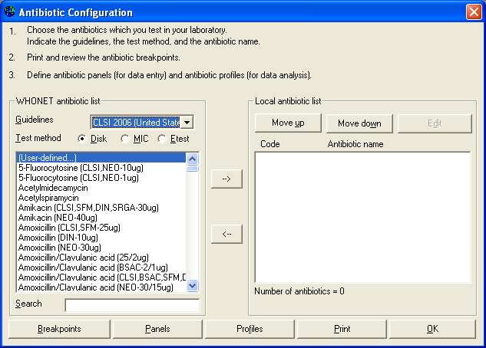
Part 1. Selecting your antibiotics
The only part of laboratory configuration which is required is indicating which antimicrobials you are testing in your laboratory.
To do this, click on “Antibiotics” to get the following screen. You will see a long list of antibiotics to your left – this is the WHONET list.
On the right is the list of antibiotic tests used in your laboratory. At the beginning this list is empty.

Slide 3
Part 1. Selecting your antibiotics
To indicate the tests that you are using, you should indicate three things:
1. the reference guidelines (for example CLSI, SFM, DIN, etc.);
2. the test method (disk, MIC, or Etest); and 3. the name of the antibiotic and, for disk diffusion testing, the disk potency.

Slide 4
Part 1. Selecting your antibiotics
In this tutorial, indicate that the method is CLSI, and you will choose a few drugs tested by disk diffusion and a few tested by Etest.
To select an antibiotic, double-click on the antibiotic to move it to the right side of the screen or single-click on the antibiotic and hit the “–>” button.

Slide 5
Part 1. Selecting your antibiotics
Find the following antibiotics, and move them to the right side of the screen.
Disk diffusion, ampicillin 10ug
Disk diffusion, cefoxitin 30ug
Disk diffusion, ceftriaxone 30ug
Disk diffusion, ciprofloxacin 5ug
Disk diffusion, erythromycin 15ug
Disk diffusion, gentamicin 10ug
Disk diffusion, imipenem, 10ug
Disk diffusion, penicillin G 10units
Disk diffusion, trimethoprim/sulfamethoxazole 1.25ug/23.75ug
Disk diffusion, vancomycin, 30ug

Slide 6
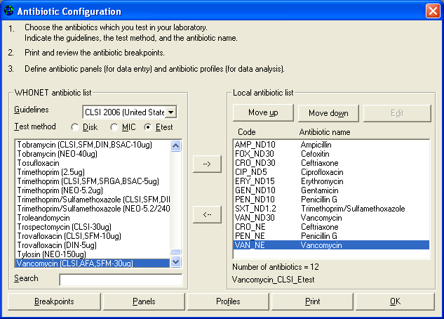
Part 1. Selecting your antibiotics
Find the following antibiotics, and move them to the right side of the screen.
Disk diffusion, ampicillin 10ug
Disk diffusion, cefoxitin 30ug
Disk diffusion, ceftriaxone 30ug
Disk diffusion, ciprofloxacin 5ug
Disk diffusion, erythromycin 15ug
Disk diffusion, gentamicin 10ug
Disk diffusion, imipenem, 10ug
Disk diffusion, penicillin G 10units
Disk diffusion, trimethoprim/sulfamethoxazole 1.25ug/23.75ug
Disk diffusion, vancomycin, 30ug

Slide 7
Part 1. Selecting your antibiotics
WHONET assigns a code to each antibiotic test, for example AMP_ND10 indicates a test of ampicillin (“AMP”) by CLSI (“N”, formerly NCCLS) methods by disk diffusion (“D”) with a 10ug disk (“10”).

Slide 8
Part 1. Selecting your antibiotics
Now enter a few drugs tested by Etest. Click on the option labeled “Etest” and select the following drugs.
Since the disk potency is not relevant for Etests, it does not matter which ”ceftriaxone” you select from the WHONET list.
Etest, ceftiaxone
Etest, penicillin G
Etest, vancomycin

Slide 9
Part 1. Selecting your antibiotics
The corresponding test code for the ceftriaxone Etest done by CLSI (formerly NCCLS) methods would be CRO_NE. After making these selections, you should have the following.

Slide 10
Part 1. Selecting your antibiotics
The corresponding test code for the ceftriaxone Etest done by CLSI (formerly NCCLS) methods would be CRO_NE. After making these selections, you should have the following.

Slide 11
Part 1. Selecting your antibiotics
Figure 3. Antibiotic configuration screen.
Select from the list of antibiotics shown to the left of the screen.
The antibiotic tests used in your laboratory appear to the right of the screen.

Slide 12
Part 1. Selecting your antibiotics
If you would like to change the sequence of antibiotics, you can use the “Move up” and “Move down” options. Or you can use the left arrow button “<–“ to remove a drug from the list.

Slide 13
Part 1. Selecting your antibiotics
After you complete the above steps, it is possible for you to proceed directly with data entry if you would like.
There are, however, a number of additional features described in Parts 3 through 6 which may be useful.

Slide 14
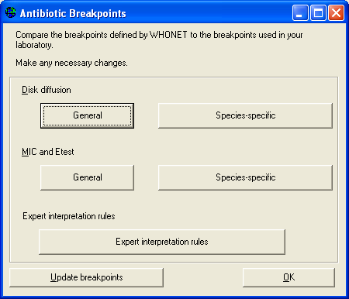
Part 2. Configuring your antibiotics
The following steps are not required, but may be useful to you.
Antibiotic breakpoints:
When you select antibiotic tests, WHONET automatically sets up the correct official breakpoints according to the reference body that you indicate.
In most cases, there will be no need for you to change these yourself. However, if there are no official breakpoints for the antibiotic that you selected or if you disagree with the breakpoints used by WHONET, then you may wish to make some manual modifications.

Slide 15
Part 2. Configuring your antibiotics
Note:
Accurate breakpoints are essential if you are entering quantitative test measurements into WHONET (for example, disk diffusion zone diameters or MIC/Etest values).
On the other hand, if you will only be entering test interpretations (“resistant”, “intermediate”, or “susceptible”), then WHONET does not use the breakpoint values.
WHONET does not require the use of test measurements, but for good quality microbiological testing and the most valuable analyses, it is strongly recommended.

Slide 16
Part 2. Configuring your antibiotics
In this tutorial, we will not change any of the default breakpoints, but to see the values suggested by WHONET, click on “Breakpoints”.

Slide 17
Part 2. Configuring your antibiotics
Figure 4. Antibiotic breakpoint configuration.
You can then view any of the disk diffusion or MIC/Etest breakpoints.
WHONET distinguishes between “General” breakpoints used for most bacterial species and “Species-specific” breakpoints for species in which the recommended breakpoint is different.

Slide 18
Part 2. Configuring your antibiotics
Figure 4. Antibiotic breakpoint configuration.
After reviewing the breakpoints, select “OK”, “OK” to return to the antibiotic configuration screen.

Slide 19
Part 2. Configuring your antibiotics
Figure 4. Antibiotic breakpoint configuration.
After reviewing the breakpoints, select “OK”, “OK” to return to the antibiotic configuration screen.

Slide 20
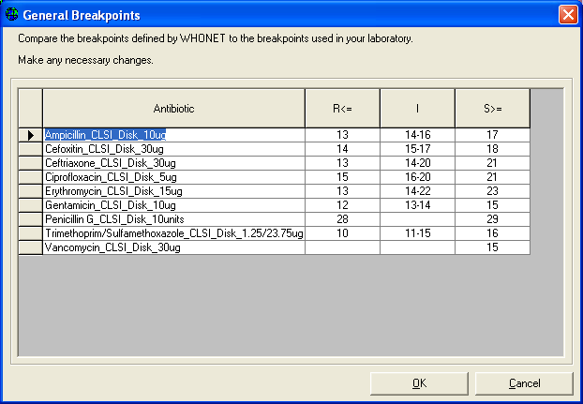
Part 2. Configuring your antibiotics
Figure 5. General and species-specific antibiotic breakpoints

Slide 21
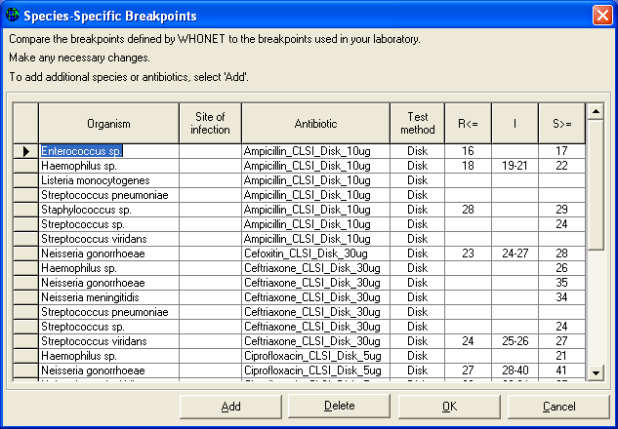
Part 2. Configuring your antibiotics
Figure 5. General and species-specific antibiotic breakpoints

Slide 22
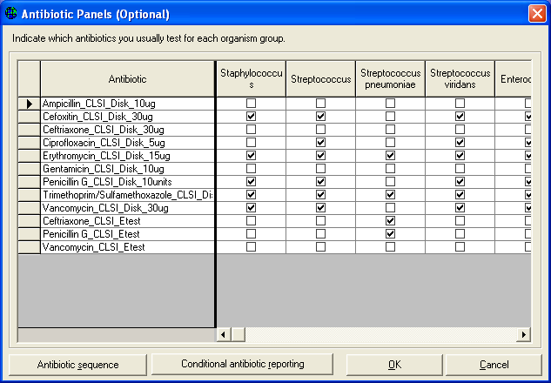
Part 2. Configuring your antibiotics
Antibiotic panels:
If you will enter results manually into WHONET, it would be useful to the data entry person if you indicate which antibiotics are tested for which organism groups.
For example for S. aureus, the software should request results from drugs used in Gram-positive infections, while for E. coli in urine samples, a different set of antimicrobials would be appropriate.

Slide 23
Part 2. Configuring your antibiotics
Antibiotic panels:
From the Antibiotic configuration screen, click on “Panels”.
You will see all of the antibiotics that you have selected in the rows, and a list of various organism groupings in the columns.
Place a check mark to indicate which drugs are usually tested for each organism.

Slide 24
Part 2. Configuring your antibiotics
Antibiotic panels:
For this tutorial, put check marks for the following organisms and antibiotics.
“Staphylococcus”: cefoxitin, erythromycin, penicillin, trimethoprim/ sulfamethoxazole, and vancomycin

Slide 25
Part 2. Configuring your antibiotics
Antibiotic panels:
For this tutorial, put check marks for the following organisms and antibiotics.
“S. pneumoniae”: erythromycin, trimethoprim/ sulfamethoxazole, vancomycin, penicillin-Etest, and ceftiaxone-Etest

Slide 26
Part 2. Configuring your antibiotics
Antibiotic panels:
For this tutorial, put check marks for the following organisms and antibiotics.
“Gram-negative”. ampicillin, ceftriaxone, ciprofloxacin, gentamicin, imipenem, and trimethoprim/sulfamethoxazole

Slide 27
Part 2. Configuring your antibiotics
Antibiotic panels:
If there is a drug that you test infrequently, for example imipenem for E. coli isolates, there is no need to include it in the panel.
The user will be able to enter results for either “panel” antibiotics or “all antibiotics” at the time of data entry.

Slide 28
Part 2. Configuring your antibiotics
Figure 6.
Antibiotic panel configuration. Indicate which antibiotics you test for each organism group.

Slide 29
Part 2. Configuring your antibiotics
Antibiotic resistance profiles:
This feature is used in the data analysis option called “Resistance profiles”. In this analysis bacteria are classified according to their multi-resistance phenotype.
This is a very valuable analysis for infection control staff when searching for outbreaks of multi-resistant organisms in the hospital setting.

Slide 30
Part 2. Configuring your antibiotics
Antibiotic resistance profiles:
Use and interpretation of this feature is described in the tutorial Data Analysis 2.

Slide 31
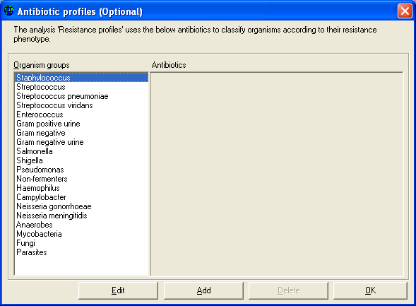
Part 2. Configuring your antibiotics
Figure 7.
Antibiotic resistance profile configuration. Indicate the drugs to be used in the study of multi-resistance patterns.
In this part of laboratory configuration, you can indicate which drugs should be used to construct the resistant profile.

Slide 32
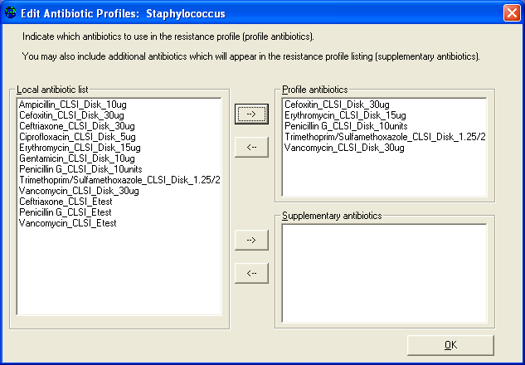
Part 2. Configuring your antibiotics
Figure 7.
Antibiotic resistance profile configuration. Indicate the drugs to be used in the study of multi-resistance patterns.
In this part of laboratory configuration, you can indicate which drugs should be used to construct the resistant profile.

Slide 33
Thank you!
On behalf of the WHONET Team, thank you for learning about the WHONET & BacLink Software!

