Slide 1
WHONET laboratory database software
WHO Collaborating centre for surveillance of antimicrobial resistance
Laboratory configuration: introduction

Slide 2
WHONET Tutorial – Laboratory Configuration
This tutorial includes the following sections.
Part 1. Describing your laboratory
Part 2. Selecting your antibiotics
Part 3. Configuring your antibiotics
Part 4. Patient locations
Part 5. Data fields
Part 6. Isolate alerts
Part 7. Finishing laboratory configuration

Slide 3
WHONET Tutorial – Laboratory Configuration
The purpose of laboratory configuration is to describe to WHONET details about your institution and your laboratory test practices. This tutorial describes how to create a “new laboratory” from the very beginning.
Note: If you will be using BacLink, there is a short-cut to accomplish most of the following steps. See the BacLink tutorials for more information. The short-cut feature is called “Create a laboratory from a data file”, and can be found under the WHONET “File” menu option.

Slide 4
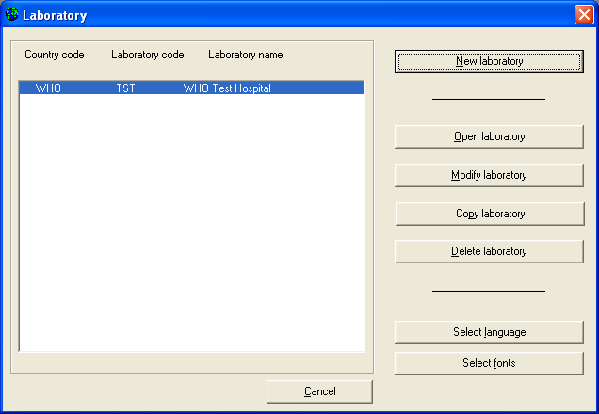
Part 1. Describing your laboratory
Double-click on the WHONET icon on your desktop to begin WHONET. You will see a list of laboratory configurations currently defined on your computer. Click on “New Laboratory” to begin.

Slide 5
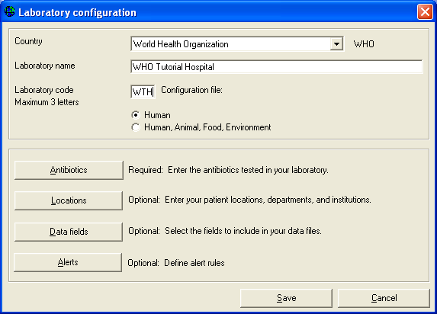
Part 1. Describing your laboratory
Figure 1. List of WHONET laboratory configurations. Select “New laboratory”.
In this tutorial, you will create an institution in the special “country” World Health Organization called “WHONET Tutorial Hospital”.
So for country, select “World Health Organization”, and for the laboratory name, type “WHONET Tutorial Hospital”. For the laboratory code, put “WTH”. Your screen should look like the below.

Slide 6
Part 1. Describing your laboratory
Figure 2. WHONET laboratory configuration screen. Enter the country, name, and code of your laboratory.

Slide 7
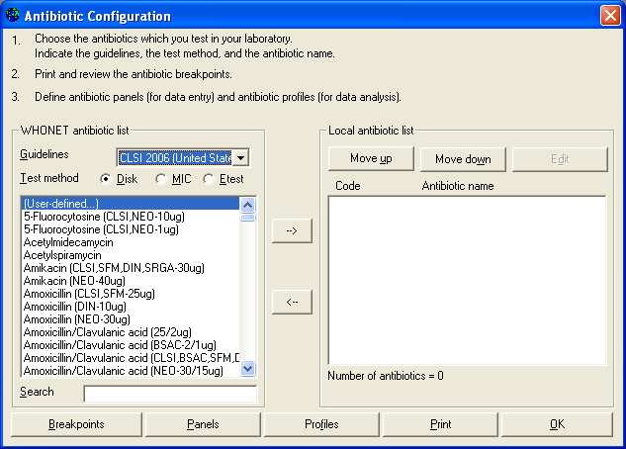
Part 2. Selecting your antibiotics
The only part of laboratory configuration which is required is indicating which antimicrobials you are testing in your laboratory.
To do this, click on “Antibiotics” to get the following screen. You will see a long list of antibiotics to your left – this is the WHONET list.
On the right is the list of antibiotic tests used in your laboratory. At the beginning this list is empty.

Slide 8
Part 2. Selecting your antibiotics
To indicate the tests that you are using, you should indicate three things:
1. the reference guidelines (for example CLSI, SFM, DIN, etc.);
2. the test method (disk, MIC, or Etest); and 3. the name of the antibiotic and, for disk diffusion testing, the disk potency.

Slide 9
Part 2. Selecting your antibiotics
In this tutorial, indicate that the method is CLSI, and you will choose a few drugs tested by disk diffusion and a few tested by Etest.
To select an antibiotic, double-click on the antibiotic to move it to the right side of the screen or single-click on the antibiotic and hit the “–>” button.

Slide 10
Part 2. Selecting your antibiotics
Find the following antibiotics, and move them to the right side of the screen.
Disk diffusion, ampicillin 10ug
Disk diffusion, cefoxitin 30ug
Disk diffusion, ceftriaxone 30ug
Disk diffusion, ciprofloxacin 5ug
Disk diffusion, erythromycin 15ug
Disk diffusion, gentamicin 10ug
Disk diffusion, imipenem, 10ug
Disk diffusion, penicillin G 10units
Disk diffusion, trimethoprim/sulfamethoxazole 1.25ug/23.75ug
Disk diffusion, vancomycin, 30ug
WHONET assigns a code to each antibiotic test, for example AMP_ND10 indicates a test of ampicillin (“AMP”) by CLSI (“N”, formerly NCCLS) methods by disk diffusion (“D”) with a 10ug disk (“10”).

Slide 11
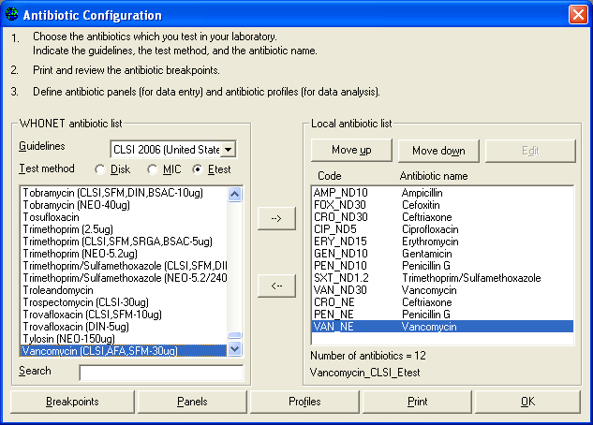
Part 2. Selecting your antibiotics
Now enter a few drugs tested by Etest. Click on the option labeled “Etest” and select the following drugs. Since the disk potency is not relevant for Etests, it does not matter which ”ceftriaxone” you select from the WHONET list.
Etest, ceftiaxone
Etest, penicillin G
Etest, vancomycin
The corresponding test code for the ceftriaxone Etest done by CLSI (formerly NCCLS) methods would be CRO_NE. After making these selections, you should have the following.

Slide 12
Part 2. Selecting your antibiotics
Figure 3. Antibiotic configuration screen. Select from the list of antibiotics shown to the left of the screen. The antibiotic tests used in your laboratory appear to the right of the screen.
If you would like to change the sequence of antibiotics, you can use the “Move up” and “Move down” options. Or you can use the left arrow button “<–“ to remove a drug from the list.
After you complete the above steps, it is possible for you to proceed directly with data entry if you would like. There are, however, a number of additional features described in Parts 3 through 6 which may be useful.

Slide 13
Part 3. Configuring your antibiotics
The following steps are not required, but may be useful to you.
Antibiotic breakpoints: When you select antibiotic tests, WHONET automatically sets up the correct official breakpoints according to the reference body that you indicate. In most cases, there will be no need for you to change these yourself. However, if there are no official breakpoints for the antibiotic that you selected or if you disagree with the breakpoints used by WHONET, then you may wish to make some manual modifications.
Note: Accurate breakpoints are essential if you are entering quantitative test measurements into WHONET (for example, disk diffusion zone diameters or MIC/Etest values). On the other hand, if you will only be entering test interpretations (“resistant”, “intermediate”, or “susceptible”), then WHONET does not use the breakpoint values. WHONET does not require the use of test measurements, but for good quality microbiological testing and the most valuable analyses, it is strongly recommended.

Slide 14
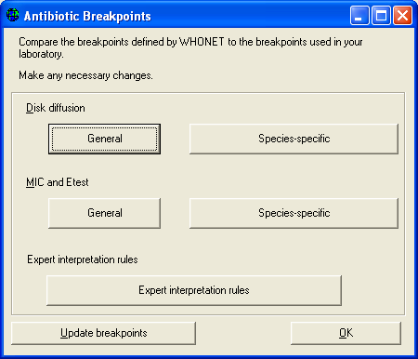
Part 3. Configuring your antibiotics
In this tutorial, we will not change any of the default breakpoints, but to see the values suggested by WHONET, click on “Breakpoints”.

Slide 15
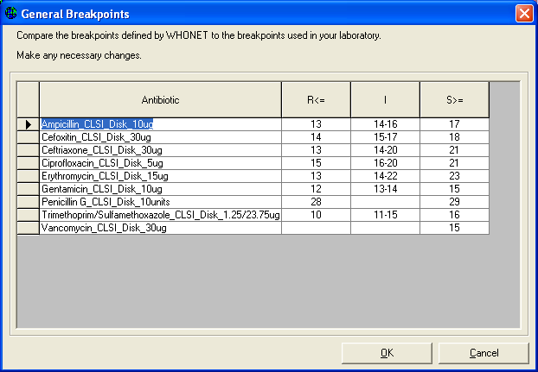
Part 3. Configuring your antibiotics
Figure 4. Antibiotic breakpoint configuration.
You can then view any of the disk diffusion or MIC/Etest breakpoints.
WHONET distinguishes between “General” breakpoints used for most bacterial species and “Species-specific” breakpoints for species in which the recommended breakpoint is different.
After reviewing the breakpoints, select “OK”, “OK” to return to the antibiotic configuration screen.

Slide 16
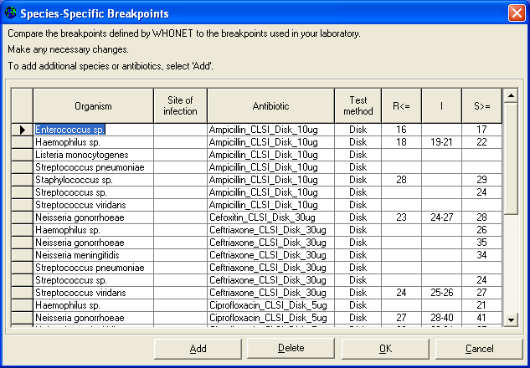
Part 3. Configuring your antibiotics
Figure 5. General and species-specific antibiotic breakpoints

Slide 17
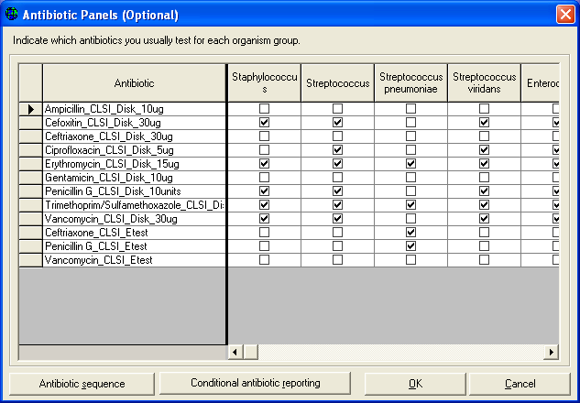
Part 3. Configuring your antibiotics
Antibiotic panels: If you will enter results manually into WHONET, it would be useful to the data entry person if you indicate which antibiotics are tested for which organism groups.
For example for S. aureus, the software should request results from drugs used in Gram-positive infections, while for E. coli in urine samples, a different set of antimicrobials would be appropriate.

Slide 18
Part 3. Configuring your antibiotics
From the Antibiotic configuration screen, click on “Panels”.
You will see all of the antibiotics that you have selected in the rows, and a list of various organism groupings in the columns.
Place a check mark to indicate which drugs are usually tested for each organism.

Slide 19
Part 3. Configuring your antibiotics
Figure 6. Antibiotic panel configuration. Indicate which antibiotics you test for each organism group.

Slide 20
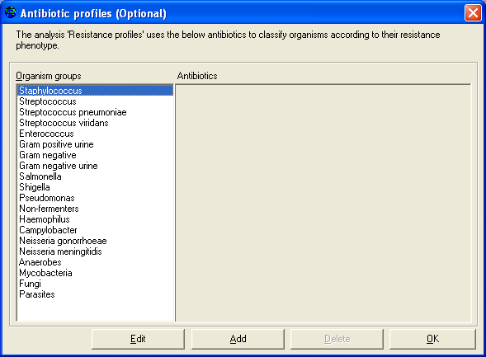
Part 3. Configuring your antibiotics
Figure 7. Antibiotic resistance profile configuration. Indicate the drugs to be used in the study of multi-resistance patterns.

Slide 21
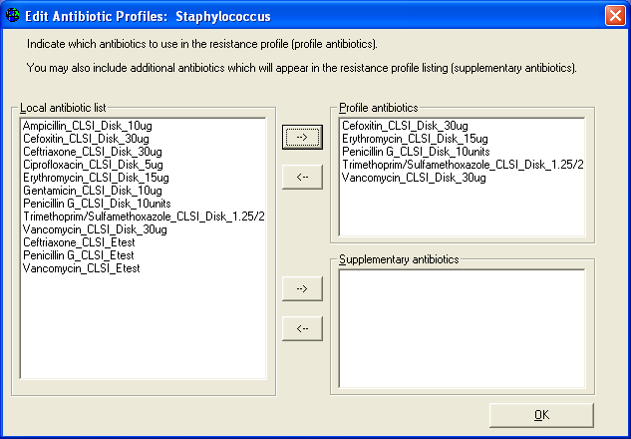
Part 3. Configuring your antibiotics
Figure 7. Antibiotic resistance profile configuration. Indicate the drugs to be used in the study of multi-resistance patterns.

Slide 22
Part 4. Patient locations
If you enter data manually into WHONET, it would be useful to enter a list of the most common patient locations from which you get clinical isolates.
Note: If you work in a public health, veterinary, or food laboratory setting, you can use the “Location” field to refer to whatever location would be of most relevance for your work – hospital, city, farm, abattoir, restaurant, market, etc. You can leave the “Department” and “Institution” columns empty if they are not relevant to your work.

Slide 23
Part 4. Patient locations
Enter the following locations and values for the columns “Location”, “Code”, “Department”, “Institution”, and “Location type”.
Neurology neuro wth med inx
Cardiac Surgery csurg wth sur inx
Neonatal ICU nicu wth neo icu
Diabetes clinic diab wth med out
Health Center #5 hc5 oth out out
Note: “med” = medicine, “sur” = surgery, “inx” = Inpatient (non-ICU), ICU = intensitve care unit, “out” = outpatient.

Slide 24
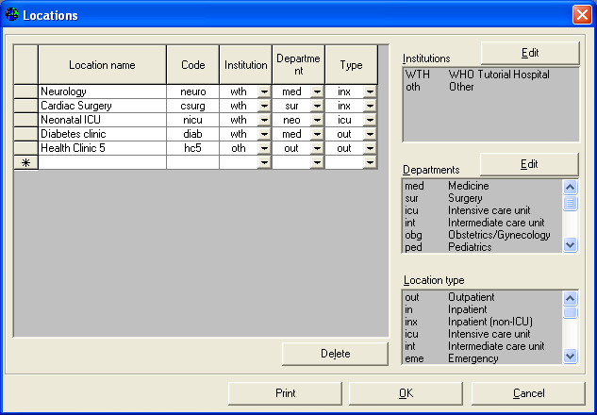
Part 4. Patient locations
Figure 8. WHONET location configuration. Indicate the locations from which you obtain your samples.
You can use the “Edit” buttons to change the list of institutions and departments to match the needs of your institution. When you finish the configuration of your locations, click on “OK” to return to the main configuration screen.

Slide 25
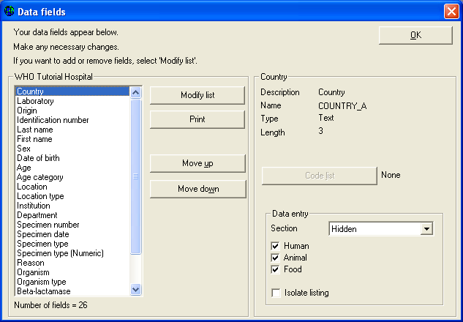
Part 5. Data fields
Figure 9. WHONET data field configuration. Indicate and modify the data fields that you want to use in WHONET. From the main configuration screen, click on “Data fields”. You will see the default list of WHONET data fields.

Slide 26
Part 5. Data fields
This list includes questions about the patient :
identification number age date of birth sex patient location location department institution location type specimen number specimen date specimen type organism serotype beta-lactamase ESBL

Slide 27
Part 5. Data fields
For most laboratories, this list is adequate for routine surveillance purposes and does not need to be edited. However for many laboratories, modifications to this list can be very useful.

Slide 28
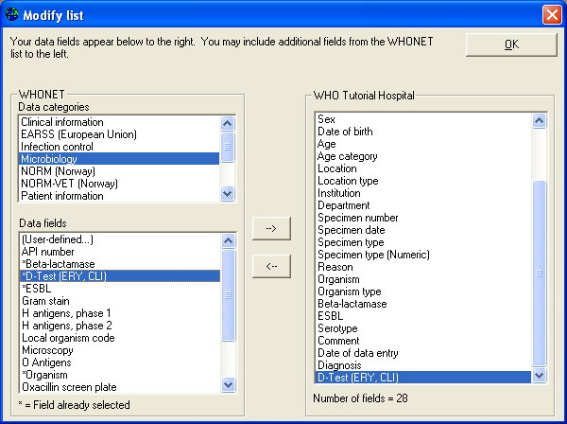
Part 5. Data fields
Adding or removing fields:
You can add additional fields to the list or remove fields that you do not need for your work. Click on “Modify list”. On the left, you will see various categories of questions and suggested fields from you to choose from. If you cannot find the field that you need, you may define a “User-defined field”.

Slide 29
Part 5. Data fields
Adding or removing fields:
For this tutorial, click on “Clinical information” as the data category and “Diagnosis” in the “Data fields” list.
Use the right-arrow key to pass “Diagnosis” to your laboratory’s field list.

Slide 30
Part 5. Data fields
Adding or removing fields:
Now click on “Microbiology” as the data category, and double-click on “D-Test (ERY, CLI)” to add this test to your list.
Then click “OK” to return to the previous screen.

Slide 31
Part 5. Data fields
Figure 10.
Add additional fields or remove fields from the list of fields for your laboratory.
In this figure, you can see a number of additional microbiological questions from which to choose.
You can also select “User-defined” if the field you would like does not appear in the WHONET lists.

Slide 32
Part 5. Data fields
Changing field lengths:
WHONET assigns a default length for each data field, but the length of most fields can be changed by the user.
For example, the location code by default is at most six characters in length. However, for many laboratories, six letters may not be sufficient.
To change the length, click on “Location”, and change the length on the right side of the screen from 6 to a larger value, for example 20.
For this tutorial, you can leave these settings unchanged.

Slide 33
Part 5. Data fields
Appearance of the data entry screen and isolate listings:
You can use “Move up” and “Move down” to change the order of the questions appearing on the data entry screen.
You can indicate whether a question applies to humans, animals, food, or environment samples.

Slide 34
Part 5. Data fields
Code lists:
If you add some additional fields to your list, you may also wish to create a list of codes to use for these fields.
For this tutorial, click on the item “Diagnosis” that you added above. Now click on “Code list”.
To enter a list of valid codes, click on “Use codes from the table below”. Then put in the following entries under the “Description” and “Code” columns:
“pneumonia”=”pneumo”, “urinary tract infection”=”uti”, “meningitis”=”mening”.
When you finish, click “OK” to return to the previous screen.

Slide 35
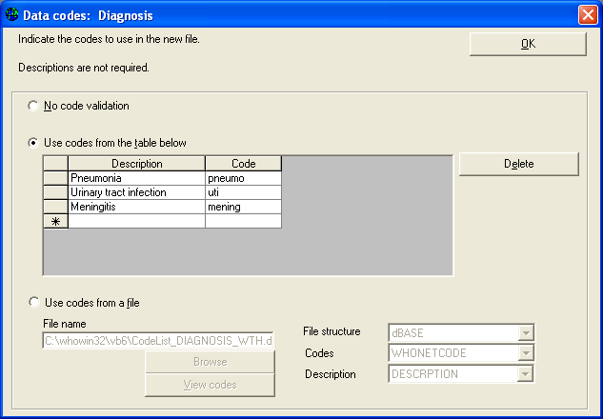
Part 5. Data fields
Figure 11. Defining a list of valid responses for the Diagnosis field.
You do not need to enter an exhaustive list. Just indicate the most common or important responses for purposes of standardizing data entry.

Slide 36
Part 6. Isolate alerts
From the main configuration screen, click on “Alerts”. You will see a long list of microbiological alerts suggested by WHONET – alerts about possible laboratory errors, important results that should be confirmed at the local or national level, and findings that should be communicated to other groups, such as the infection control team. You can easily activate or deactivate the rules suggested by WHONET.
You can also use “New rule” to define additional alerts specific to your institution or country. When you finish reviewing or defining rules, click on “OK” to return to the main configuration screen.
These features are described in greater detail in the tutorial “Expert System”.

Slide 37
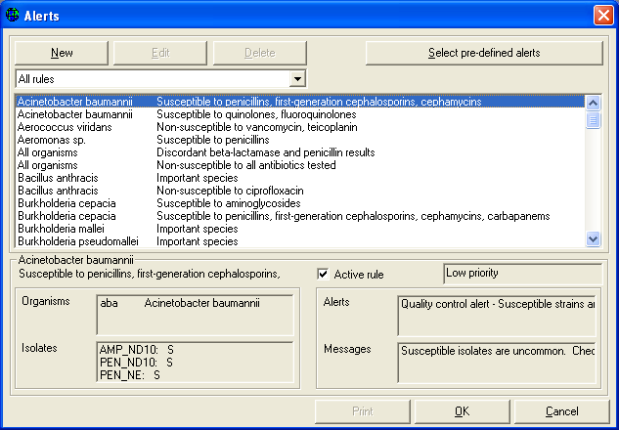
Part 6. Isolate alerts
Figure 12. List of microbiological alerts for your laboratory. In addition to the pre-defined WHONET alerts, you can also define your own alerts with “New”.

Slide 38
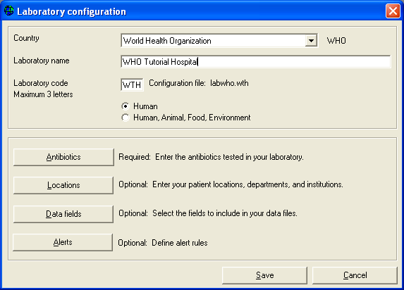
Part 7. Finishing laboratory configuration
You have now finished your laboratory configuration.
Click on “Save” to save all of the laboratory details into a “laboratory configuration file.
The name of the file has the form “labxxx.yyy” where “xxx” refers to the country code and “yyy” refers to the laboratory code.
For example, in this tutorial, the laboratory configuration will have the name “labwho.wth”.

Slide 39
Part 7. Finishing laboratory configuration
You can return to laboratory configuration to make additional changes at any time by selecting “Modify laboratory”.
Now that you have finished configuration of your laboratory, you can now continue with the tutorial on Data Entry.

Slide 40
Thank you!
On behalf of the WHONET Team, thank you for learning about the WHONET & BacLink Software!

