Slide 1
WHONET laboratory database software
WHO Collaborating centre for surveillance of antimicrobial resistance
Data entry: view database

Slide 2
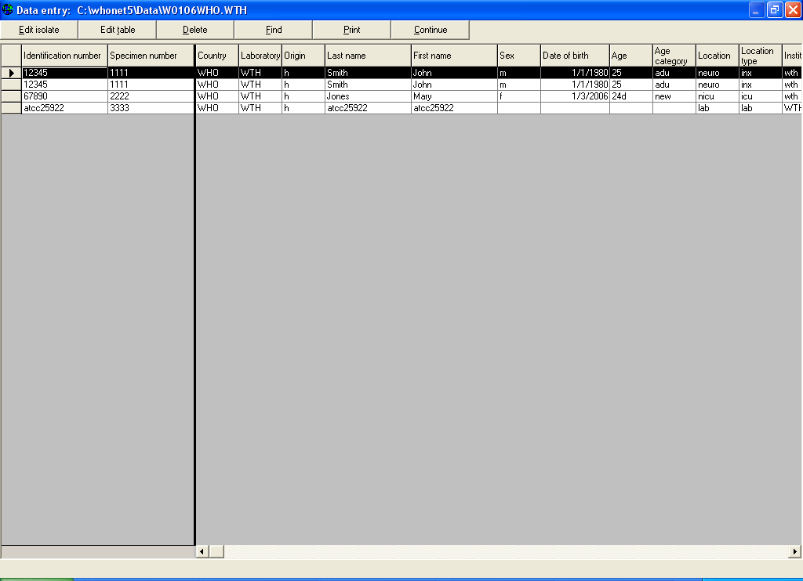
Part 3. Viewing the database
Figure 7.
Viewing the database in table format. You have now entered the results for four strains into WHONET.
To see these results, click on “View the database” to get the following screen listing all of the results.

Slide 3
Part 3. Viewing the database
Figure 7.
From this screen, you have a number of options:
Sorting the results:
If you click on any column heading, WHONET will sort the database by that column.
This can help you to find results from a certain patient or with a certain organism.
It can also help find errors in data entry, for example in the specimen date column.

Slide 4
Part 3. Viewing the database
Figure 7.
From this screen, you have a number of options:
Edit the isolate:
If there is a mistake in the database or if you have additional information to add, click on “Edit the isolate” to edit the isolate on the main data entry screen.
When you finish, click on “Save isolate”.

Slide 5
Part 3. Viewing the database
Figure 7.
From this screen, you have a number of options:
Edit the table:
You can also edit the table directly.
Click on “Edit the table” and you can make changes directly to the table.

Slide 6
Part 3. Viewing the database
Figure 7.
From this screen, you have a number of options:
Delete:
Use this button to delete a record.

Slide 7
Part 3. Viewing the database
Figure 7.
From this screen, you have a number of options:
Delete:
Use this button to delete a record.

Slide 8
Part 3. Viewing the database
Figure 7.
From this screen, you have a number of options:
Print:
This feature is described further in the next step.

Slide 9
Part 3. Viewing the database
Figure 7.
From this screen, you have a number of options:
When finished reviewing these features, click on “Continue” to return to the main Data entry screen.

Slide 10
Thank you!
On behalf of the WHONET Team, thank you for learning about the WHONET & BacLink Software!

