Slide 1

WHONET 2023 and WHO GLASS 2.0
September 27, 2023
John Stelling, MD, MPH, jstelling@whonet.org
Brigham and Women’s Hospital, Harvard Medical School, Boston
WHO Collaborating Centre for Surveillance of Antimicrobial Resistance

Slide 2
Webinar agenda
Introductions
WHONET Updates
Demonstration of GLASS-AMR export from WHONET 2023
Demonstration of GLASS-AMR import into WHO GLASS DHIS
Possible topics for future webinars
Questions and answers

Slide 3
Updates on WHONET
John Stelling, MD, MPH
Brigham and Women’s Hospital
WHO Collaborating Centre for Surveillance of Antimicrobial Resistance
Manila 18 September, 2023

Slide 4
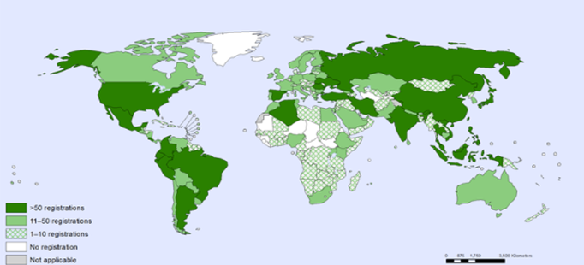
Overview of WHONET
WHONET is a free software for the management, analysis, interpretation and reporting of microbiology laboratory data with a particular focus on antimicrobial resistance.
WHONET is used in over 130 countries for human, animal, food, and environmental samples.
While the data come from microbiology laboratories, users of the software include laboratory, pharmacy, infection control, and infectious disease staff, epidemiologists, policymakers, and researchers

Slide 5
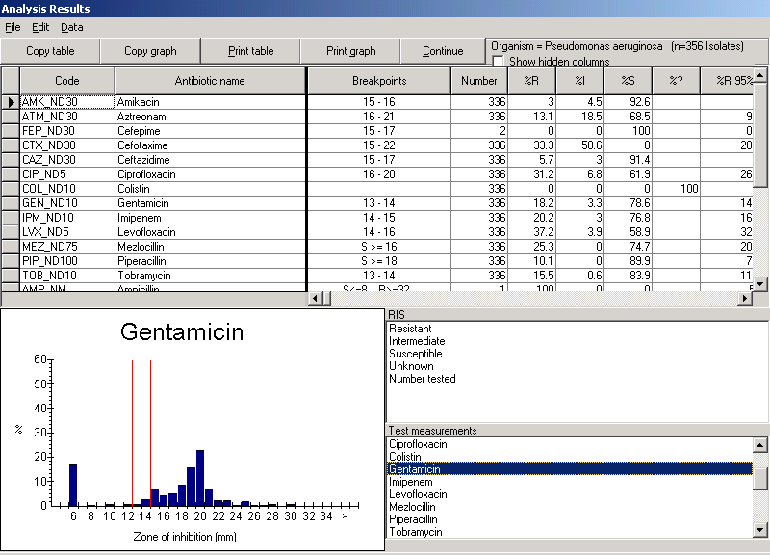
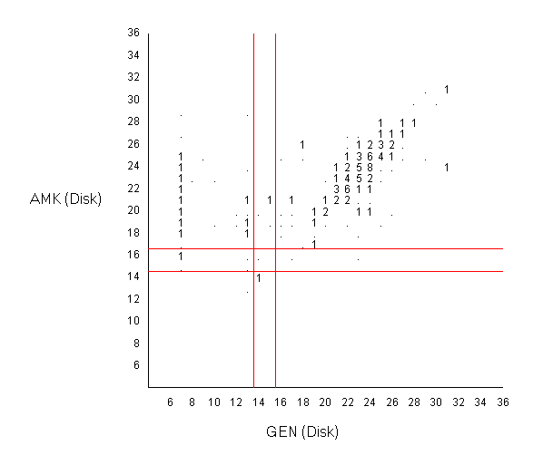
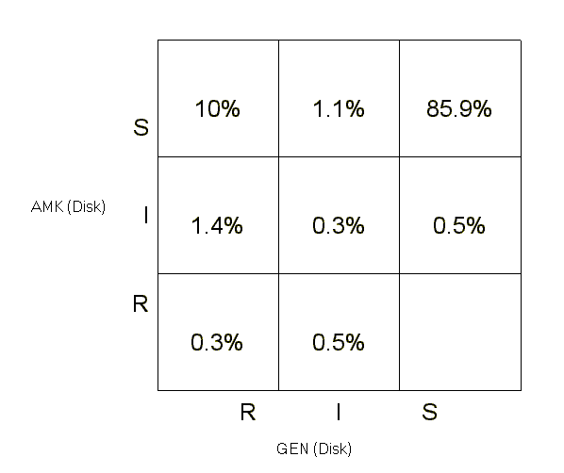
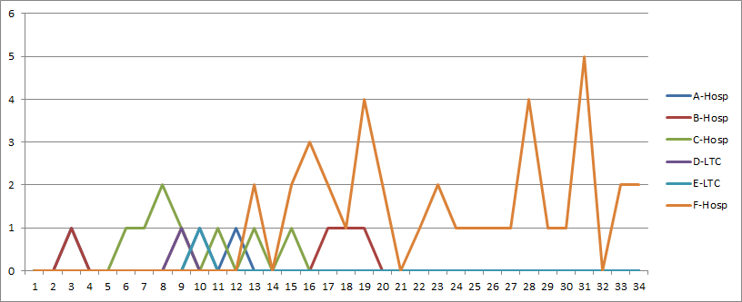
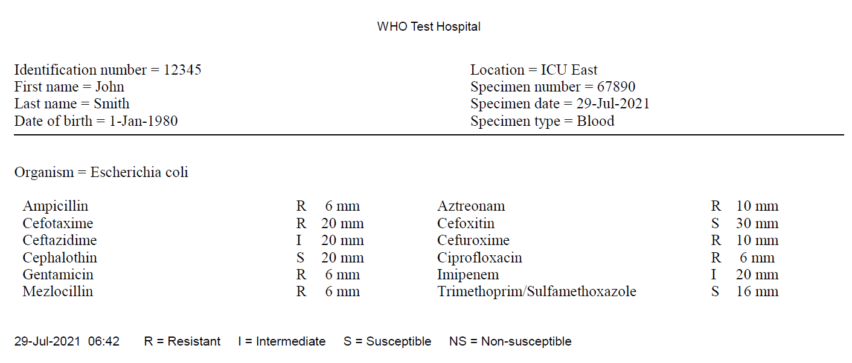
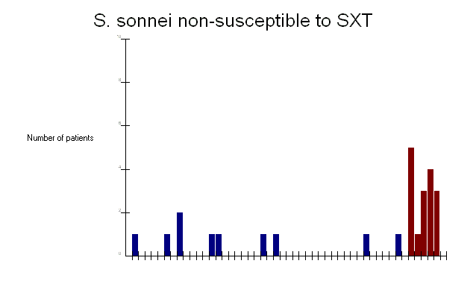
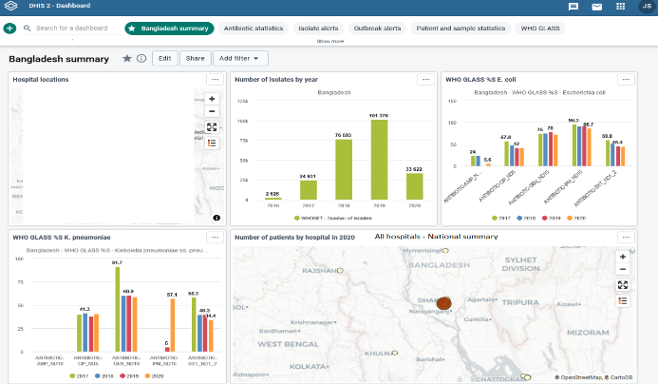

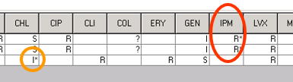
Some WHONET analysis and reporting features
%RIS and histograms
Scatterplot
MDR tracking
Clinical reports
Hospital F
Hospital C
Hospital B
Nursing homes
DHIS2
Outbreak detection
WHO GLASS
Microbiology alerts

Slide 6
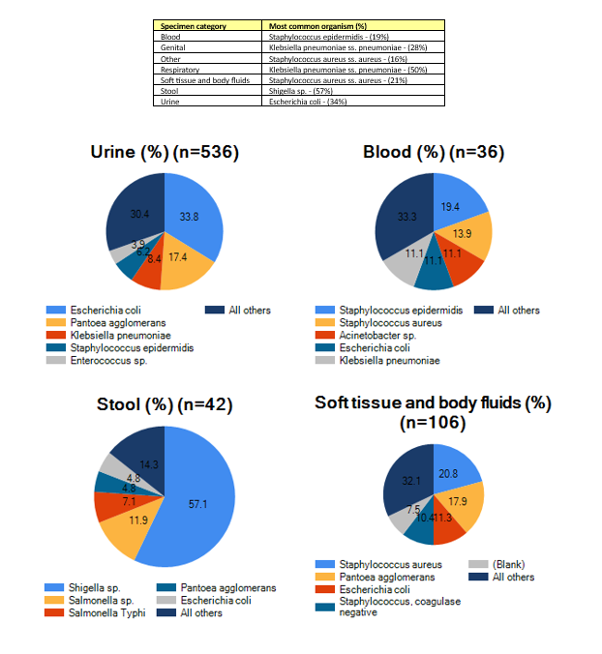
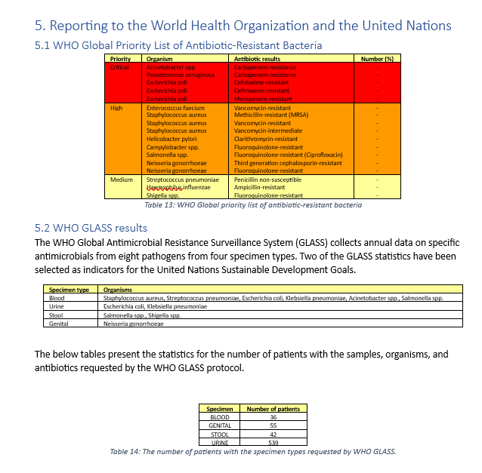
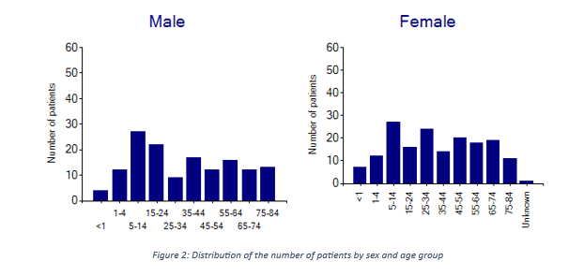
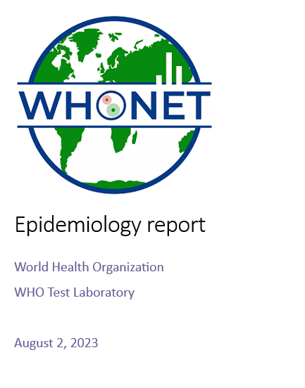
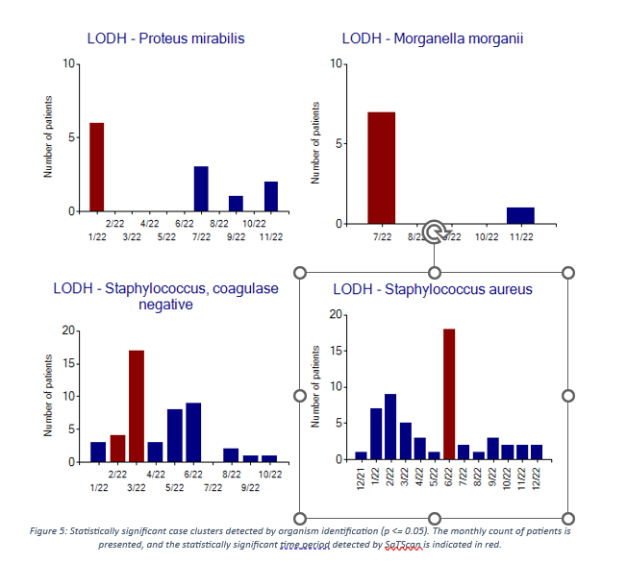
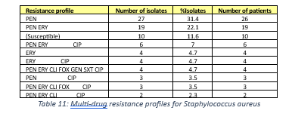
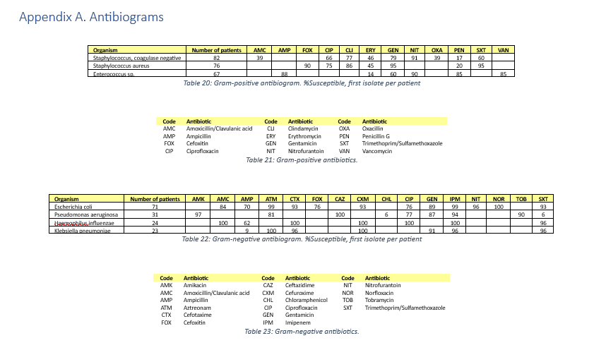
WHONET Epidemiology and Data quality reports

Slide 7
Data entry – Import with BacLink
Most laboratories in the medium- and high-resource world already have computer systems for managing their microbiology data… and also many laboratories in low-resource settings.
    Simple desktop systems: Excel, Access,…
    Laboratory instruments: Vitek, Microscan, BD Phoenix, etc.
    Laboratory information systems: Commercial or in-house
This is an obstacle because they are not directly compatible. But it is also an opportunity! The electronic data have already been stored.
The goal of BacLink is converting data from existing incompatible systems into common WHONET files.
WHONET
BacLink
Incompatible local systems
Standard WHONET files

Slide 8
Implementation in WPRO – Part 1
Country/Area | WHONET Use |  | Country/Area | WHONET Use
Australia | Used by some individual laboratories |  | Malaysia | National network since early 1990s
Brunei Darussalam | Not utilized |  | Mongolia | Basis for national program
Cambodia | Compatible with CamLIS |  | New Zealand | Not utilized
China | 1,300 laboratories |  | Papua New Guinea | National program supported by Fleming Fund
- Hong Kong SAR | Used by some individual labs |  | Philippines | National network since 1988
- Macao SAR | Not utilized |  | Republic of Korea | Was basis for national program, but new system in place
Japan | Compatible with JANIS |  | Singapore | Used by some hospitals for local purposes
Lao PDR | National program supported by Fleming Fund |  | Viet Nam | National network since early 1990s

Slide 9
Implementation in WPRO – Part 2
Country/Area | WHONET Use |  | Country/Area | WHONET Use
American Samoa | Compatible with Vitek |  | Nauru | Training in Honlulu 7/2023
Cook Islands | Introduced, not used at present |  | Northern Mariana Islands, Comm. of the (USA) | Used for several years by one laboratory
Fiji | Compatible with STARLIMS |  | Palau | Used for a few years by one laboratory
French Polynesia (France) | Training in Honolulu 7/2023 |  | Pitcairn Island (UK) | Not utilized
Guam (USA) | Training in Honolulu 7/2023 |  | Samoa | Compatible with Excel files
Kiribati | Training in Honolulu 7/2023, Visit in 8/2023 |  | Solomon Islands | Compatible with Excel files
Marshall Islands | Training in Honolulu 7/2023, Visit in 8/2023 |  | Tokelau (NZ) | Training in Honlulu 7/2023
Micronesia, Federates States of | Training in Honolulu 7/2023 |  | Tonga | Was used in past, Training in Honlulu 7/2023
Nauru | Training in Honolulu 7/2023 |  | Tuvalu | Visit in February 2023
New Caledonia (France) | Training in Honolulu 7/2023 |  | Vanuatu | Training in Honlulu 7/2023
Niue | Training in Honolulu 7/2023 |  | Wallis and Futuna (France) | Training in Honlulu 7/2023

Slide 10
WHONET Updates
Current projects support by WHONET
  Fleming Fund activities: Lao PDR, Papua New Guinea, Viet Nam. CAPTURA, RADAAR, WHONET Strategic Alignment Grant
  COMBAT-AMR: Fiji, Papua New Guinea, Samoa, Solomon Islands. Project ended. Phase 2?
  American Society of Microbiology – CDC Pertussis project: Brazil, Mexico
  EARS-Net, PATH, CRDF Global (Japan), MSF, Wellcome
WHONET Training Centre – Development of an OpenWHO course
WHONET Discussion Forum
WHONET User Survey

Slide 11
Changes to RIS and Sample files in GLASS-AMR 2.0
RIS file
  Additional specimen types, organisms, and antibiotics
  Removal of ATC categories, e.g. Carbapenems = J01DH
  Refinement of “GENITAL” to “UROGENITAL”, “ANOGENITAL”, and “PHARYNGEAL”
Samples file
  Additional specimen types
  NUMINFECTED = Number of patients infected with a GLASS pathogen
If you try to submit GLASS 1.0 files to the GLASS 2.0 platform, you will receive “Blocking errors”

Slide 12
Use of the RIS and Samples files
RIS file
  Epidemiology of antimicrobial resistance for key specimen type, organism, antimicrobial combinations stratified by priority variables
Samples file
  Quantifying the amount of testing performed by the laboratory, e.g. “Number of blood cultures”, including: 1) specimens with GLASS pathogens; 2) specimens with non-GLASS pathogens; and 3) negative samples, such as “No growth” and “Normal flora”.
  This is of value for tracking the amount of testing that is performed by the laboratory – “Diagnostic stewardship”
  It can also be used to track metrics such as “%Positivity”
  The Samples file has little value if you do not include statistics from all positive and negative samples – and there is no need to upload it to the WHO GLASS IT platform

Slide 13
WHO GLASS-AMR Variable – Infection origin
Epidemiologically, it is useful to distinguish statistics from infections of hospital origin (HO) from infections of community origin (CO).
  One approach is to do individual patient review of all samples to make a decision. But this is impractical, time-consuming, and subject to significant variability between individuals.
  A simpler “proxy” approach is much more practical and standardized.
    If a sample is collected in the outpatient setting, we will call it a CO infection.
    If a sample is collected inside a hospital location:
      If the sample is collected on Hospital Day 1 or 2, then we consider this to be a CO infection requiring hospitalization.
      If the sample is collectyed on Hospital Day 3 or later, then we consider this to be a HO infection.
This definition is not perfect and is not always correct on a case-by-case basis, but it has practical value for statistical purposes.
  It does require the “Date of admission”, which often is not available in laboratory databases. Without the date of admission, WHONET will consider the origin of hospital isolates to be “Unknown = UNK”.

Slide 14
Possible topics for future webinars
WHONET 2024 release
WHONET analysis and reporting features
  WHONET isolate and outbreak alerts
  WHONET Quick analysis reports
  WHONET DHIS2-AMR module
  WHONET Automation Tool
  WHONET AST interpretation engine
WHONET Community
  WHONET Training Center
  WHONET Discussion Forum
One Health features of WHONET – FAO and InFARM
Country-, region-, and/or language-specific sessions

