Slide 1


BacLink Training Course
Introduction to BacLink, Part 1
Division of Infectious Diseases, Brigham and Women’s Hospital, Boston, United States
WHO Collaborating Centre for Surveillance of Antimicrobial Resistance

Slide 2
1
BacLink Training Course Modules
Introduction to BacLink
Creating a local data file
BacLink configuration – Part 1
Converting data with BacLink
BacLink configuration – Part 2
Getting started with WHONET

Slide 3

1
Module 1. Introduction to BacLink
A
What is BacLink?
Download and installation
BacLink main screen
B
C

Slide 4
1
A
What is BacLink?
Notes:
1

Slide 5
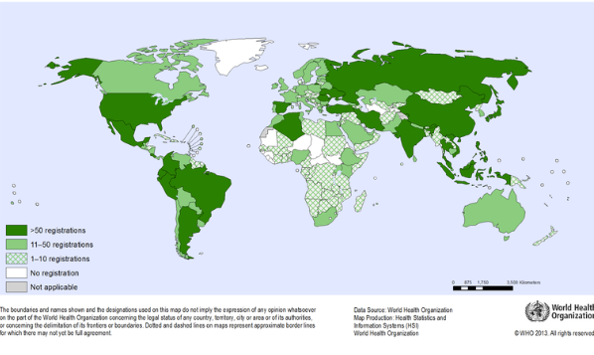
1
What is WHONET?
A
  WHONET is a widely-used free software developed for the management and analysis of microbiology laboratory data to support local, national, regional, and global activities to understand and fight infectious diseases with a special focus on antimicrobial resistance.
WHONET is a desktop software developed for Microsoft Windows
.
You can also run WHONET on MacOS computers utilizing a Windows partition, a Windows Virtual machine, or a Windows emulation software.

Slide 6
1
Laboratory data management systems
A
Many laboratories in the world continue to rely on paper notebooks to management their microbiology test results. For these laboratories, WHONET could be a very appropriate system for clinical reporting and data analysis.
  However, BacLink is not needed since there is no local IT system
Most laboratories do have some data system in place:
  Very simple desktop applications, such as Microsoft Excel. This is common in low-resource settings. It is also common for special research projects and protocols.
  Laboratory instruments
    MIC instruments: Vitek, BD Phoenix, MicroScan, Sensitire, etc.
    Disk diffusion camera systems (some of which can also read MIC plates): SIRScan, Biomic, etc.
  Laboratory Information Systems
    Locally developed versus national versus international
    Free versus commercial
    Some systems only cover microbiology test results, while others also support other clinical laboratory areas, such as blood bank, hematology, and biochemistry

Slide 7
1
Who should learn BacLink?
A
If your laboratory does not have digital records for your microbiology data, then you do not need BacLink. You can enter data manually into WHONET directly.
If your laboratory has a data management system, then BacLink should be a very useful software, but only for data managers directly responsible for data preparation, who are primarily laboratory staff, IT staff, perhaps infection control staff, and national surveillance data teams.
For clinicians, pharmacists, policymakers, and others involved in data analysis, interpretation, and reporting:
Many will find that learning WHONET is useful for their work.
However, if they are not directly involved in the capture of data from existing data management systems, then they do not need learn BacLink.

Slide 8

1
The purpose of BacLink
A
Situation: Laboratories around the world have diverse systems that serve important functions for day-to-day laboratory, clinical reporting, medical archives, and billing. However, these systems are incompatible and usually have minimal capabilities for data analysis and public health reporting.
Opportunity: Staff have taken the time and effort to computerize laboratory results on a daily basis. If we can extract these data into compatible systems, we have the basis of a low-cost, sustainable, real-time system for surveillance, alerts, and action.
Purpose of BacLink – Transformation of data exported from diverse existing and incompatible systems into standardized WHONET files for purposes of analysis, sharing, and public health reporting.
BacLink
Incompatible local systems
Standard WHONET files

Slide 9
1
Alternative approach without BacLink
A
When you use BacLink, there are two steps for creating WHONET files:
  Exporting data from the laboratory system; and
  Importing data into WHONET files utilizing BacLink.
There is another approach using a single step, but it is not usually recommended.
  If provided with the WHONET data specifications, LIS developers can develop a routine that creates WHONET files directly without using BacLink.
  However, creating this kind of export requires much more work for the developers to create WHONET data files and to map all of the local data codes to WHONET equivalents.
  It also requires a commitment to long-term maintenance by the IT team as new data fields, organisms, antibiotics, and other data values are added to WHONET over time.
  So, this approach is possible but rarely implemented.

Slide 10
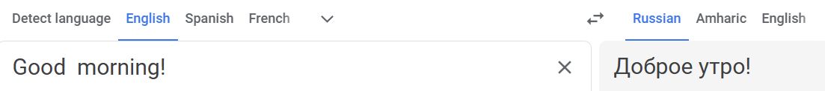
1
Comparison of BacLink and Google Translate
A
BacLink and Google Translate both have the objective to convert information from one “language” into another. For example:
  Google Translate: Converting “English” or “Russian” or “Chinese” into “Spanish” or “Thai” or “Hindi”.
  BacLink: Converting “Excel” or “Vitek” or “SEDRI-LIMS” into “WHONET”.
Google Translate must understand “Grammar” and “Vocabulary”.
Similarly, BacLink must understand “Data structure” and “Data codes”
  “Date of birth” in WHONET could be “Birthdate” or “DOB” or “Fecha de Nacimiento” in other systems.
  “Cerebrospinal fluid” in WHONET could be “CSF” or “Líquido cefalorraquídeo” in other systems

Slide 11
1
Getting data from your system into WHONET
A
Step 1: Export data from your system
Step 2: Examine your data file: contents and structure
Step 3: Configure BacLink to understand your data file structure and codes
Step 4: Use BacLink to convert your data into WHONET files
Step 5: Getting started with WHONET
Optional - Step 6: Automated daily downloads and conversions

Slide 12
1
Step 1. Export data from your system
A
For Excel and Access, you already have your file
  No need for IT department
For laboratory instruments, there are simple steps for exporting data
  No need for IT department
  Sometimes you can configure the export and choose the data fields to export. In other cases, there is a fixed export that cannot be changed.
For laboratory information systems:
  Assistance from IT department is usually needed
    For many it is a simple, standard feature that already exists
    For others, the IT department will need to create an export
    For others, there is no simple way to get the data out
    You can download the results of “all samples” or only the “positives” or only the “positives with AST results”.
  You tell the IT department the results that you want to include in the export.

Slide 13
1
Step 2. Examine your data file
A
Content: Is the desired information in the data extract?
  Patient: Name, Patient ID, Sex, Age/Date of Birth, Date of admission
  Location: Sampling location
  Specimen: Specimen date, Specimen type, Specimen number
  Organism: Organism
  Antibiotic results: Name, interpretation, method, measurement
  Other (but usually not available): Diagnosis, Physician, Gram stain, etc.
Format: Are the data elements nicely structured?
  Simple rows and columns
  Try to avoid “Free text” and inconsistencies in date formats
  Each data element should be in its own cell. Don’t put more than one organism or more than one antibiotic result into a single cell
Collaborate with the IT developers until you are satisfied with the data content and data format

Slide 14
1
Options for data file cleaning
A
Use Excel or similar tool
Use BacLink

Slide 15
1
Cleaning your data with Excel
A
Considerations
  Advantages: Full flexibility in recoding and combining fields
  Disadvantages: Can be tedious, must be repeated on each file, cannot be automated

Slide 16
1
Cleaning your data with BacLink
A
Code-mapping functions in BacLink
  Direct mapping:
    “ESCCOL” in your system = “eco” in WHONET
    All results = “Healthy terrestrial animals” in WHONET as a “Fixed value”
  Indirect mapping:
    “Neurology Ward” in your system = “Neurology Ward”, “Medicine”, “Inpatient” in WHONET
    “Perdue farm #10” in your system – “Perdue Farm #10”, “Farm” in WHONET
Considerations
  Advantages: Medium flexibility, more convenient for repetitive data conversions, can be automated
  Disadvantages: Less flexibility than Excel
We will see this today with “Locations”, “Specimen types, “Organisms”, and “Antibiotics”. Also valuable for other fields, especially with free text.

Slide 17
1
Step 3. Configure BacLink
A
BacLink needs to know
  Your country and laboratory codes
  The kind of data you want to import
    How do your data fields (for example “Birthdate”) match up with the WHONET data fields (for example “Date of birth”)
    What kind of antibiotic test results do you have and how are they organized?
    For many systems (Vitek, MicroScan, Cerner, etc.), BacLink already knows the answers
  You only have to do this once
Your codes and date formats
  Your date formats: Day/Month/Year, Year-Month-Day, etc. You only have to do this once
  Your data codes: How do your local codes match up with the WHONET codes: sex, specimen, organism, antibiotics, etc. You only have to do this once for each code.

Slide 18
1
Organization of antibiotic results
A
Guidelines
  CLSI, EUCAST, Other
Methods
  Disk, MIC, Etest: One method or multiple methods
Organization
  One record = One isolate (“horizontal”)
  One record = One antibiotic (“vertical”)
Results
  Measurements, interpretations, both

Slide 19
1
Step 4. Converting data with BacLink
A
Tell BacLink
  The kind of data you want to import
  The name of the local data file that you want to convert
  A name for the new WHONET file that you want to create
Then “Begin conversion”
  BacLink will show you the first three isolates so that you can check the quality of the conversion
  If BacLink finds codes that it doesn’t understand (specimens, organism, etc.), then you will have the chance to define then
    BacLink can do some automatic mapping, for example “Blood” or “Sangre” or “Blut” or “Кровь” in the local system to “Blood” in WHONET.
    For other code mappings, you will do that with the BacLink code mapping interface.

Slide 20
1
Step 5. Getting started with WHONET
A
BacLink and WHONET do not talk to each other. So WHONET doesn’t know anything about the work that you did in BacLink.
We want to add your new laboratory to this list of WHONET laboratories
You could use “New laboratory” in WHONET, however, there is a much better way. WHONET offers a shortcut to creating a new laboratory!
  Start WHONET and click “Cancel”
  Select “File”, “Create a laboratory from a data file”
  Tell WHONET the name of the new file that you created with BacLink
  WHONET will scan this file and create a new configuration that matches it. You are now ready to analyze your data with WHONET.

Slide 21
1
Step 6. Task automation (Optional)
A
For many systems, you can configure the automation of data exports from your LIS, data imports with BacLink, and data analysis, reporting, and email alerts with WHONET
  You could schedule this for daily, weekly, or monthly processing.
Automation of the data export from your LIS
  You will need to discuss this with your LIS support. Most LIS do permit automated data exports, but not all.
Automation of the data import with BacLink
  You can use a “task scheduler” preferred by your IT team or the WHONET Automation Tool (ask the WHONET Team for assistance)
Automation of data analyses with WHONET
  You can use a “task scheduler” preferred by your IT team or the WHONET Automation Tool (ask the WHONET Team for assistance)
  You define WHONET macros and reports for the analyses that you would like to run automatically. You can have separate daily/weekly/monthly reports for laboratory staff, infection control teams, pharmacists, and others.

Slide 22
1
BacLink demonstration
A
Choosing the language
Part 1: Data capture of priority data fields
  Configuration – Priority fields
  Data conversion – Priority fields
  Date formats
  Code mapping
Part 2: Data capture of secondary data fields
  Data conversion, Part 2
  Code mapping, Part 2
  Data conversion - Final
Getting started with WHONET

Slide 23
1
BacLink demonstration – Sample data files
A
Included with the WHONET installation package
  Vitek2-demo-data.txt
  ExcelDemo.xlsx
Other example
  SILAB – Veterinary laboratory information system

Slide 24
1
Summary
A
BacLink is free software distributed as part of the WHONET package
  If your laboratory already has a data management system, you can use BacLink to convert data exported from your system into standardized WHONET files
    You can make WHONET files without BacLink, but this usually takes much more time and effort to implement and a commitment to long-term maintenance is required.
  You can use BacLink to capture your data manually on a weekly, monthly, quarterly, yearly, or ad hoc basis
  You can also use BacLink to capture your data automatically, for example, on a daily, weekly, or monthly basis

Slide 25
1
B
Download and installation
Notes:
1

Slide 26
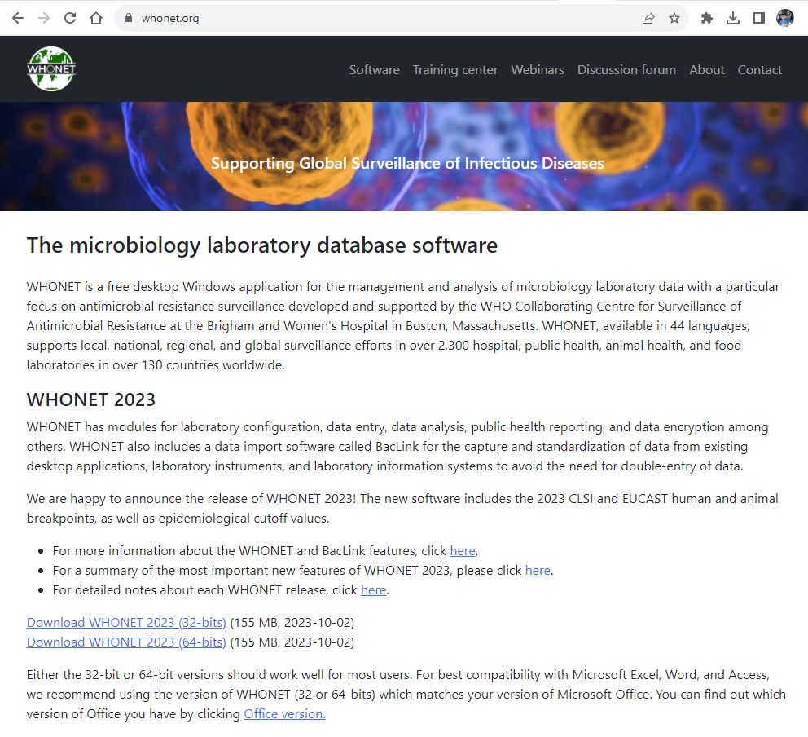
1
WHONET Home page – www.whonet.org
B

Slide 27
1
C
BacLink Main Menu
Notes:
1

Slide 28
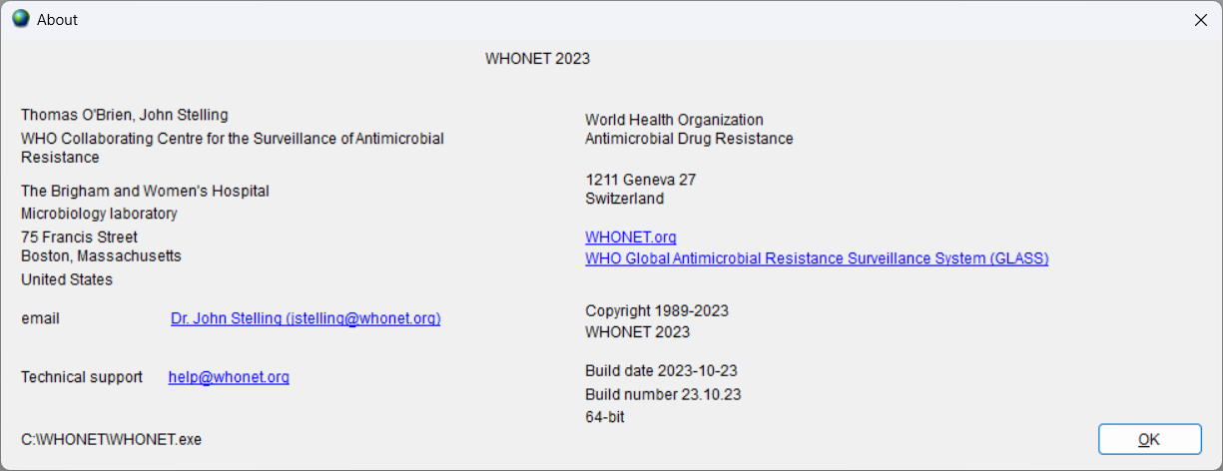
1
Help -> About
1
C

Slide 29
1
Thank you for watching Module 1:
Up next. Module 2: Laboratory configuration

