Slide 1
baclink data import module
WHO Collaborating centre for surveillance of antimicrobial resistance
Data import: phoenix coniguration

Slide 2
BacLink Tutorial – Exporting data from Meditech
The instructions are divided into four parts:
Part 1. WHONET and Meditech
Part 2. Exporting data with Meditech: You will use the Meditech NPR report generator to create a text file with the desired microbiological information.
Part 3. Converting data with BacLink: BacLink will convert the file that you created with Meditech to a WHONET file
Part 4. Getting started with WHONET
The purpose of this document is to guide users of the Meditech laboratory information system through the export of data to WHONET. These instructions should prove a valuable resource for data managers who are completely unfamiliar with the Meditech report generation and data extraction utilities and a time-saver for data administrators who are.

Slide 3
BacLink Tutorial – Exporting data from Meditech
We anticipate that these instructions should work well with Meditech Magic versions 4.8 and up. We have not yet developed guidelines for extraction of data from Meditech Client/Server. For Meditech users familiar with the creation of NPR reports, feel free to edit the reports to best suit your data management needs.
The frequency of data conversions depends on the local data analysis needs and interests. Many laboratories find that a weekly or monthly download is adequate for their infection control and quality assurance purposes, while less frequent analysis may be adequate if the principal use of the data is in following trends in resistance and guiding treatment recommendations. Automated daily downloads of data from Meditech into WHONET is also a possibility, but is not described in this manual.

Slide 4
Part 1. WHONET AND MEDITECH
The purpose of this document is to guide users of the Meditech Laboratory information system through the export of data to WHONET.
The instructions are divided into four parts:
1. Downloading and installing WHONET and BacLink
2. Exporting data from Meditech
3. Converting data with BacLink
4. Getting started with WHONET
The frequency of data conversions depends on the local data analysis needs and interests. Many laboratories find that a weekly or monthly download is adequate for their infection control and quality assurance purposes, while less frequent analysis may be adequate if the principal use of the data is in following trends in resistance and guiding treatment recommendations.

Slide 5
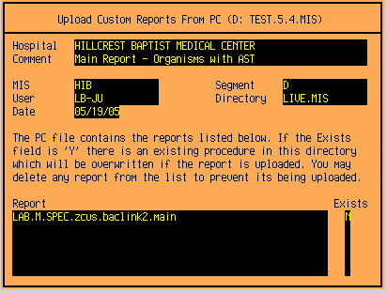
PART 2. EXPORTING DATA WITH MEDITECH
1. Installing the BacLink NPR reports
After installing WHONET, you will find copies of two BacLink NPR files “meditec1” and “meditec2” in the subdirectory c:\whonet\machines. If you do not know how to upload an NPR report into your Meditech system, consult with your IT support staff or contact John Ucci directly at the above e-mail. Most users with sufficient access will utilize the “Upload Reports from PC” option on the “NPR Customization Menu”, as illustrated in the figures below.

Slide 6
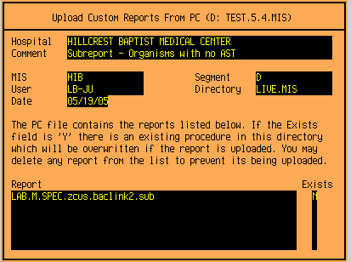
PART 2. EXPORTING DATA WITH MEDITECH
2. Selecting the Meditech data
Select the “BacLink NPR download” to run from either a menu or directly through the NPR Customization Process Reports routine. The date selection window appears:
BACLINK DOWNLOAD
From Collection Date
Thru Collection Date
Note that the date range selection is by specimen Collection Date

Slide 7
PART 2. EXPORTING DATA WITH MEDITECH
3. Creating the data file
After entering the date range selection, the Print On window appears.
There are three options at this point: DOWNLOAD, SPOOL and SCHED. Alternatively, automated transfer to an FTP site is also possible.

Slide 8
PART 2. EXPORTING DATA WITH MEDITECH
3a. Download
If DOWNLOAD is selected, a Suppress: Nothing, Page banners, Form feeds, or Both? window may appear. Select N.
The Save As window opens. Direct the report to the location you wish to store the downloaded data. This location will vary from site to site. Important: Remember the location you save the download file to and be consistent in using the same location. The location can be on the local hard drive (C:\) or on a network (\\servername\) where “servername” represents the local server storing the data.

Slide 9
PART 2. EXPORTING DATA WITH MEDITECH
3a. Download
The downloaded files are conveniently saved to the WHONET data directory or another directory of the users choice. For example: C:\whonet\data or \\servername\whonetdata \\servername\whonet\data or \\servername\whonet\download.
Once the file location is selected, enter a valid Windows file name. Since the export files will have a text file structure, you may wish to include the extension “.txt”, “.csv” or “.dat”. Try to use a consistent naming convention. For example, if the data are downloaded monthly, appropriate names for the January 2022 data file include: jan2022.txt, w0103.txt, micro_2022.01, etc.

Slide 10
PART 2. EXPORTING DATA WITH MEDITECH
3a. Download
Click “Save” to save the file to the selected location. Note: Be careful that an existing file name is not used. There is no warning message provided and previously saved data can be overwritten. Depending on the selected date range, the report will take a few seconds to a few minutes to complete.
Once the data are downloaded to a file, End Of Report appears.

Slide 11
PART 2. EXPORTING DATA WITH MEDITECH
3c. FTP
A data file can be scheduled to download directly to a specified location on a local hard drive or network server by configuring a FTP host in MEDITECH (Version 4.9 and higher). Again, discuss this option with the MEDITECH IS analyst.

Slide 12
Thank you!
On behalf of the WHONET Team, thank you for learning about the WHONET & BacLink Software!

