Slide 1
baclink data import module
WHO Collaborating centre for surveillance of antimicrobial resistance
Excel and text file configurations

Slide 2
Part 2. Preparing your file for BacLink
Unfortunately, BacLink does not have a direct import option for Excel files, so we need to make some modifications to create a file that can be converted with BacLink.
First of all, you should delete any extraneous information in the Excel file which is not part of the data to be converted – for example graphs or unneeded descriptive information. The data to be converted should begin in the cell A1, as in the example. So for the sample file used in this tutorial, no data “cleaning” is needed.
You then need to save the Excel file in a format compatible with BacLink. The most convenient format is a delimited text file format. To do this, click on “File”, “Save as”. Instead of using the default “Excel Workbook” format, click on “Save as type” and select the option “Text (Tab delimited) (*.txt)”.
Note: For a step that we will come to later, remember that Excel, by default, is using “Tab” as the field delimiter.

Slide 3
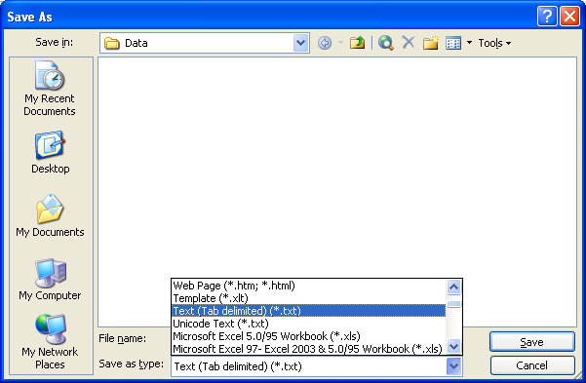
Part 2. Preparing your file for BacLink
When you select “Text (Tab delimited)” as your file format, Excel will change the name of the file from “ExcelDemo.xls” to “ExcelDemo.txt”. Now click on “Save”. When you click on “Save”, you will get two warning messages.

Slide 4
Part 2. Preparing your file for BacLink
The first message warns you that Excel cannot save all three Excel Sheets as a text file as once. Since we only want to save the active sheet, click “OK”.

Slide 5
Part 2. Preparing your file for BacLink
The second message warns you that you will lose special formatting, such as bold letters, fonts, and lines when you save an Excel file as a text file. Since we are only interested in the data, and not the Excel formatting of the data, this is not a problem. So in answer to the question “Do you want to keep the workbook in this format?”, click “Yes”.
We will now leave Excel completely. Click on “File”, “Exit”.

Slide 6
Part 2. Preparing your file for BacLink
Excel will give you one more warning message.

Slide 7
Part 2. Preparing your file for BacLink
In this warning message, Excel asks if you want to save the changes to the data file. Since you just saved the file in the previous step, there is no need to save the file again. So click “No”.
If you look at your c:\whonet\data folder, you will now see that there is a file called “ExcelDemo.xls” (the original file) and a file called “ExcelDemo.txt” that you just created with Excel. We will use BacLink to convert the latter file to WHONET format.

Slide 8
Thank you!
On behalf of the WHONET Team, thank you for learning about the WHONET & BacLink Software!

